Slide 1
1920’s Political, Social, Economic Happenings

Slide 2
Fear Mongering
Red Scare – Fear of communist infiltration in US society
Palmer Raids – Attorney General ordering the lockup of suspected anarchists/communists
Scheneck v. U.S. – Gov is justified in prosecuting free speech issues if a “clear and present danger” is at issue.
Sacco and Vanzetti – prosecuted, convicted, executed for personal beliefs rather than evidence.

Slide 3
Labor
Strikes – Boston Police Strike, Steel and Coal strikes struck down by Warren G. Harding administration.
  There is no right to strike against the public safety by anybody, anywhere, anytime.”
United Mine Workers – agreed to not strike during WWI, but protested wages after war was over. Gov forced them to go back to work.

Slide 4
Politics
“Return to Normalcy” – get the federal government back to a laissez-faire (hands off) role in business/labor/international issues
President Warren G. Harding elected protesting progressive leadership.
  Pro-business, anti-labor, low-or-no taxes, high protective tariffs, anti-immigration.
Isolationist – avoiding political or cultural involvement in foreign affairs.
Disarmament – No military (navy), no chance of military conflict.
  Washington Conference: US/foreign countries limit navies.

Slide 5
Isolation
Nativism – favoring US born peeps.
  Anti-city: immigrants go to the cities (slums)
  Unions resented immigrants (scabs)
  Anarchists/communists (red scare)
No League of Nations
Fordney-McCumber Tariff – raise tariff rates on all imported goods. Make the goods more expensive than American-made goods.
Kellogg-Briand Pact: 15 nations agreed not to use the threat of war in dealing with one another.

Slide 6
Economics
Warren G. Harding – Republican.
Sec of Treasury – Andrew Mellow
Sec of Commerce – Herbert Hoover
  Gov should not regulate business. Capitalism at its finest.
Fix debt and grow the economy at the same time: Trickle Down Economics
Eliminate debt by cutting spending on government programs (sequester)
(a)Cut taxes on the wealthy and they (b) buy more stuff which (c) increases demand and that increases (d) jobs.

Slide 7
Teapot Dome Scandal
“Ohio Gang” group of WGH buddies lined their pockets with bribes from special interests.
Teapot Dome Scandal: WGH knew his White House associates were leasing federal lands to oil interests and not giving the money to the federal government.
Harding died before problems came to light.
VP Calvin Coolidge becomes president.

Slide 8
Silent Calvin Coolidge
Gov agencies (ICC and FTC) are supposed to end trusts.
Coolidge appointed fellas who were business friendly.
Coolidge appointed pro-business judges
Sec. of Treasury was the 3rd wealthiest person in the United States.
Millionaires paid less than 1/3 of the taxes in 1926 than in 1921.

Slide 9
Laissez-Faire Capitalism
Tax cuts lead to lots of excess money.
Invest or spend?
1,000 business mergers for efficiency.
200 corporations worth ½ of national wealth.
  Dow Jones
American Plan – eliminate union negotiations from the workplace. Reduce protections for lab

Slide 10
Herbert Hoover
Campaign Phrase – “Wonderful Prosperity”. The sky is the limit for American wealth/prosperity.
  Richest .1% = 34% of all bank savings
  Poorest 80% = no savings.
Stock Market – A “market” where people meet to buy/sell ownership in private companies.
Brokers/Speculators – investors in the stock market
Speculation – buying stock/bonds for the purpose of increasing value over time.
Stock – ownership in a company.
Bond – Loan to government or company paid back with interest or a lump sum amount.

Slide 11
Deregulation
No rules governing buying/selling stock.
“Buying on the Margin” – plop down 10% of the cost per share of stock, borrow the rest on credit.
Bull Market – overall stock values increase in value over a short period of time.
Bear Market – overall stock values decrease in value over a period of time.
Bubble – overinflated value of a stock. Not a realistic price.

Slide 12
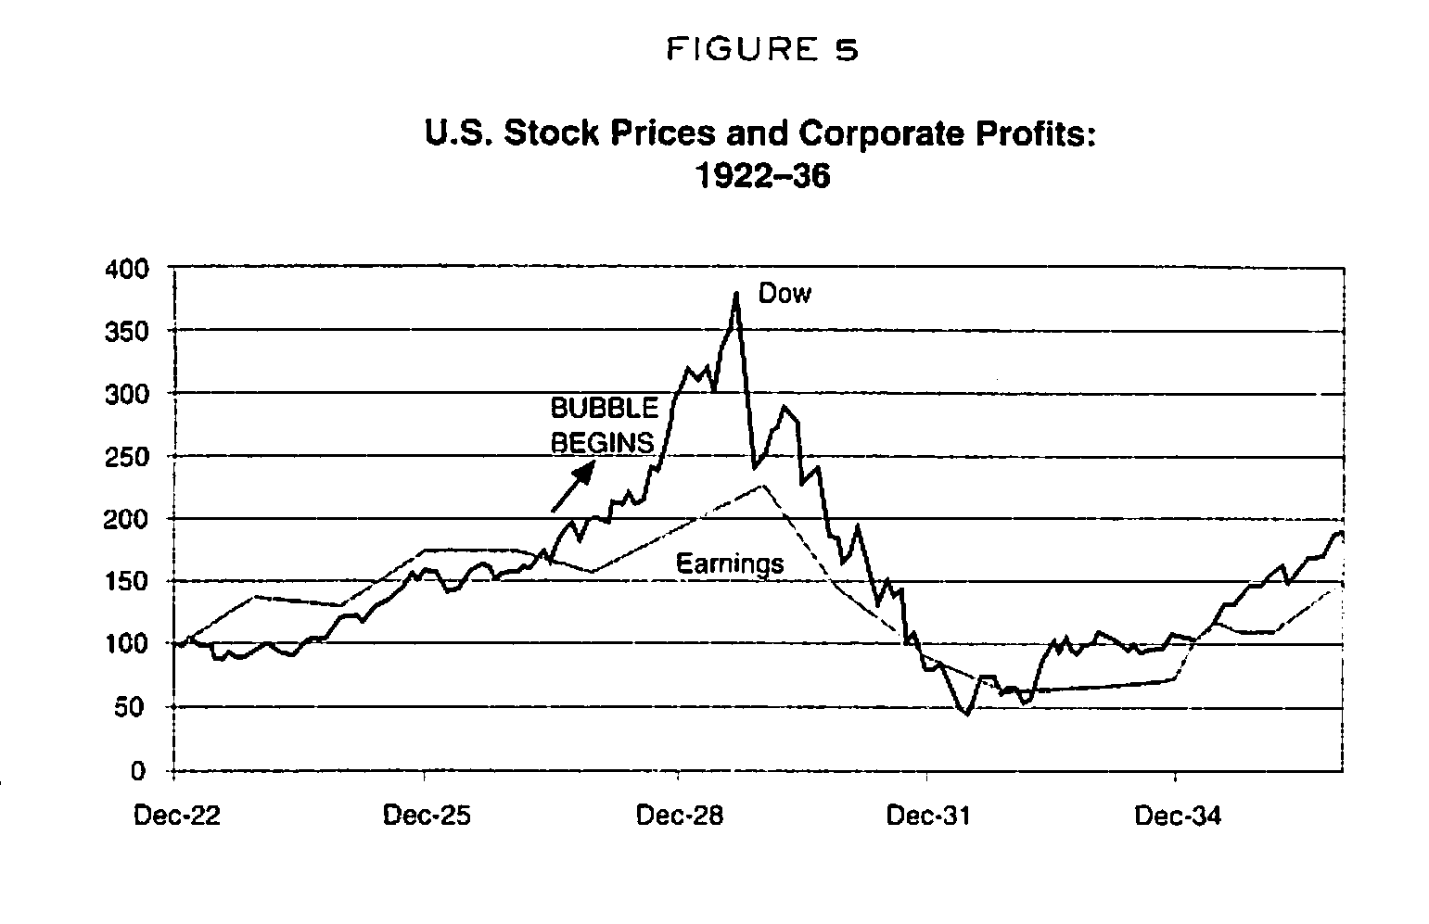
Stock Market Bubble 1929ish

Slide 14

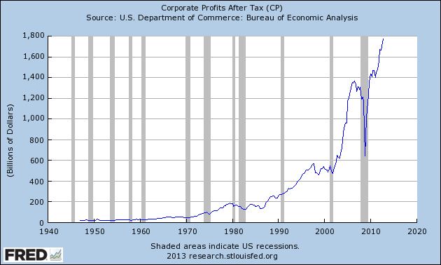
Stock Market Bubble 2013?

Slide 15
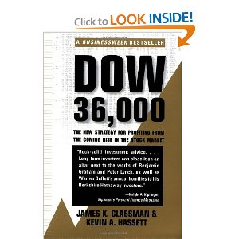
Stock Market Crash
John J. Raskob – Influential trader. Buy! Buy! Buy! No way the market will ever go down.
  Dow Jones 36000
Speculation.
Loan from bankish place.
Buying on margin with loan
from bankish place.
Weakness in the Economy
Black Tuesday – Stock values collapse.

Slide 16
Weakness in the Economy
Overproduction of industrial/agricultural goods.
Farmers bought extra land to produce extra crops during WWI. Price values declined after WWI because extra supply lowers cost.
To make up for the lower cost of wheat, corn, etc., farmers produce even more goods, lower prices further.
Farmers can’t make enough money to recoup cost, land gets foreclosed.
Ditto with industry.

Slide 17
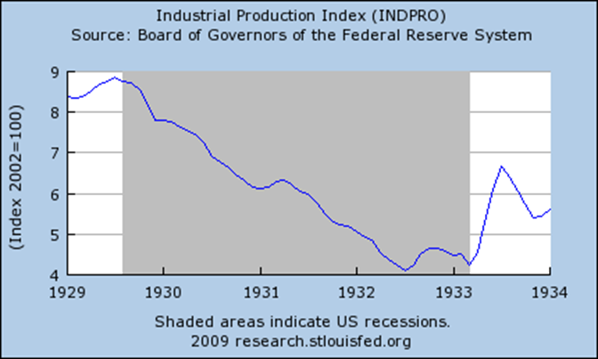
Industrial Production

Slide 18
Don’t Panic!
GDP (GNP) – value of all goods/services produced in the US any given year.
  1933 – GDP fell by ½
Bank sector trouble. Foreclosed property means no income for banks. No income, banks shut down…with your savings in the bank.
No savings? What happens if you lose your job?
No house.
Uh-oh.

Slide 19
What to do
Business cycle – Is this just a up-down roller-coaster cycle of business?
Smoot-Hawley Tariff – increased tariffs on imported goods to promote American good purchases.
Rugged Individualism – This tough time will make us all tougher in the end. What doesn’t kill you…
Ag. Marketing Act – US gov buys excess crops lowering supply, increasing prices.
Home Loan Bank Act – loans to people to keep paying their mortgages.
Reconstruction Finance Corp – Gov program loaning money to big industries to stay open, produce goods, keep people employed.

Slide 20
Issues
Moral Hazard – Gov bailout of business, industry, etc., removes incentive to not fail.
“Too big to fail.”
GM – Go bankrupt. Learn the lesson!
But…400,000 people lose their jobs.
Ripple effects – diners, retail, cars. Nationwide consequences.
1930’s – End of capitalism?
2008 – Repeat of Great Depression?

Slide 21
What to do?
Federal Reserve –
Monetary Policy –
Interest Rate –

Slide 22
