Slide 1
American Imperialism

Slide 2
Growth
Imperialism -- Extending rule of authority of an empire or nation over foreign countries, or acquiring colonies as dependents.
Economic – increased need for raw/natural materials (oil, rubber) to make finished goods; new markets for exports
Nationalism – more territorial control creates national pride in empire status
Military -- require bases around the world to control properties
Humanitarian – religious or superior attitude in civilizing native populations

Slide 3
Europe
Britain – “The sun never sets on the British Empire.” See list of colonies here.
France – Indochina, Africa
Spain – Caribbean, Central/South America
Germany – Africa, China
Belgium – Africa
Treaty of Berlin (1885) – European powers agree to peacefully carve “spheres of influence” out of Africa.

Slide 4
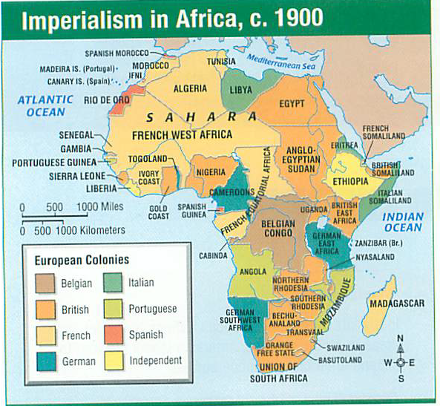

Slide 5
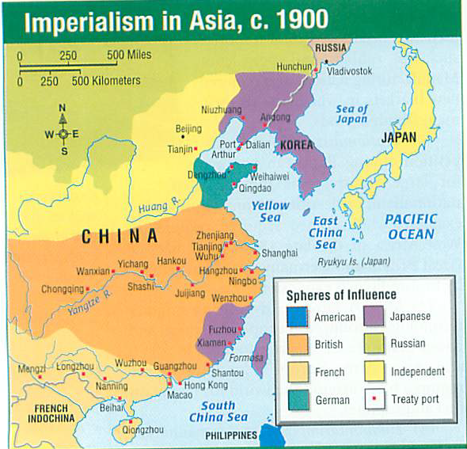

Slide 6
G. Washington
Farewell Address – steer clear of foreign alliances. Ok. Become isolationist and industrial.
But…things change.
1853 – Commodore Matthew Perry sailed US fleet to Tokyo and “convinced” Japan to trade with US. Japan – isolationist for 200 years.
Trade with Japan gets you to China.
Alaska Purchase – 1867 purchase of Alaska from Russia. “Seward’s Icebox” or “Seward’s Folly”
Walrus hides and icebergs.
Oil, gold/silver, fishing

Slide 7
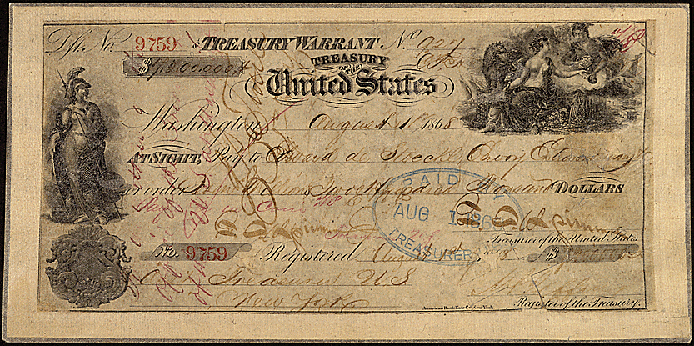

Slide 8
Little Islands
Refueling stations for US ships.
Midway Islands in 1867
Trade treaty with Hawaii in 1875 (sugar).
Samoa in 1899

Slide 9
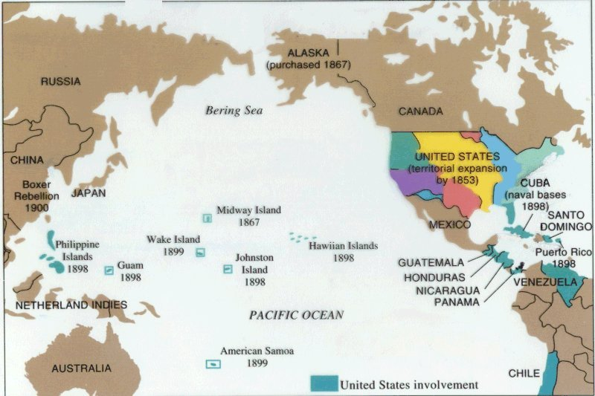

Slide 10
Bidness
Surplus of goods in America; need to expand abroad.
Central and South America. It’s close.
Minor C. Keith – United Fruit Company. Sells fruit from lands in Costa Rica, Guatemala and Honduras = nicknamed “Banana Republics”.
Monroe Doctrine
Steer clear of Europe
Europe steer clear of Central and South America. You can keep the colonies you already own.

Slide 12
In the navy…
Alfred Mahan – wrote a book: Influence of Sea Power on History, 1660-1783.
Story of what European NAVY?
Britain!
Need overseas markets
Need a powerful battleship-driven navy
Need overseas bases for refueling navy

Slide 13
So…build a big navy
Naval Advisory Board (1881) – increase budget and ships.
Naval Act of 1890 – Construct battleships and smaller gunboats.
Great White Fleet – America’s most powerful battleships built by 1907. See next.
Battleship Diplomacy – use the potential destructive power of the navy to settle international disputes.

Slide 14
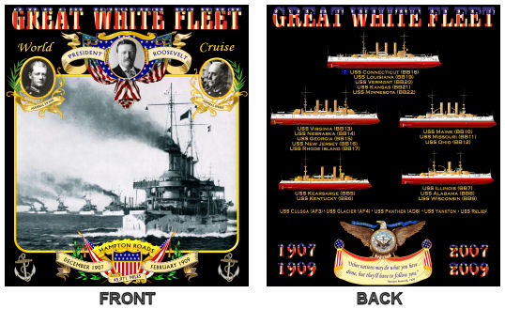

Slide 15
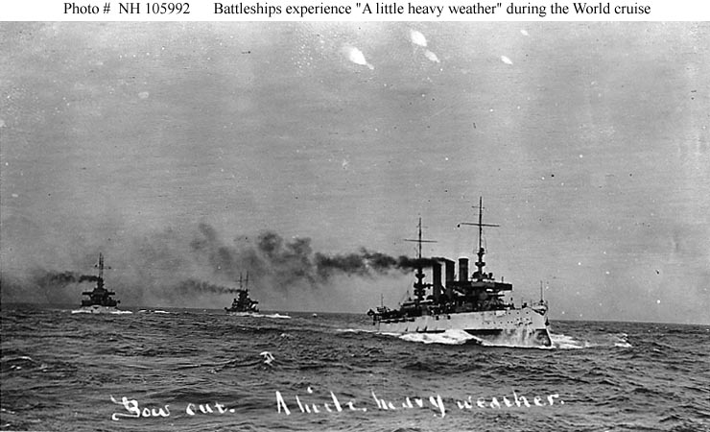

Slide 16
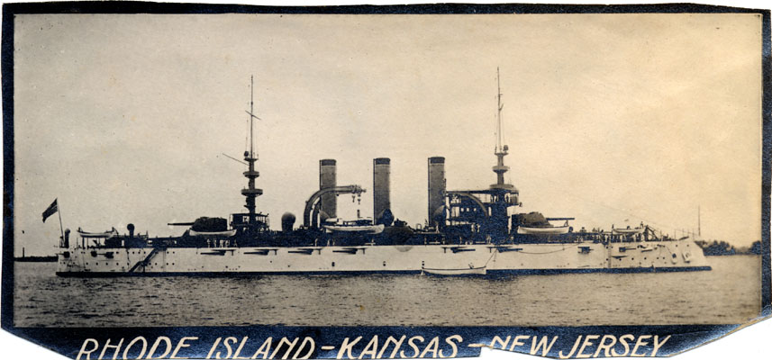

Slide 17
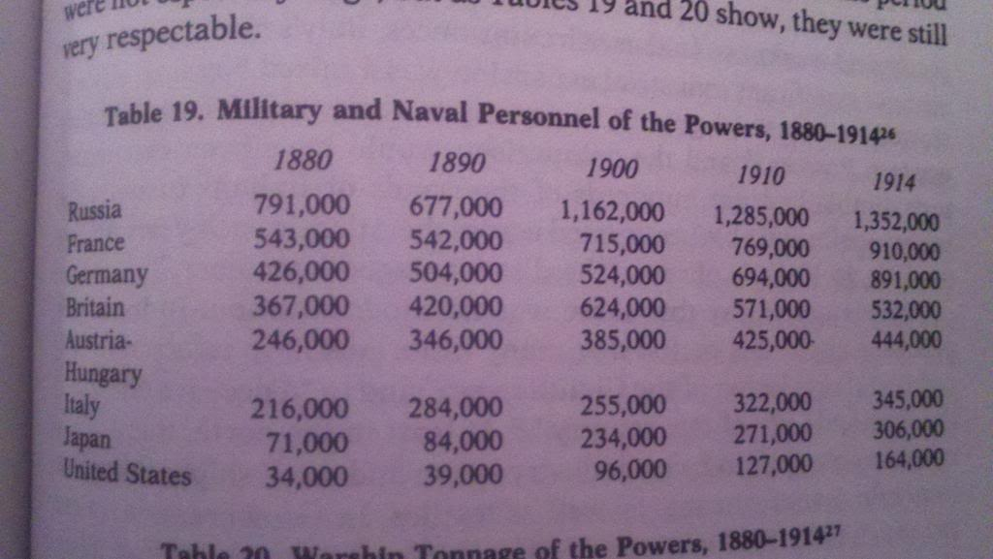

Slide 18
Other Considerations
Humanitarian
Rudyard Kipling – White Man’s Burden
Civilize, Christianize, or dominate the natives.
Or opium (heroin and morphine) could subdue the population.
British mixed tobacco and opium to make a cheap drug to subdue populations

Slide 19
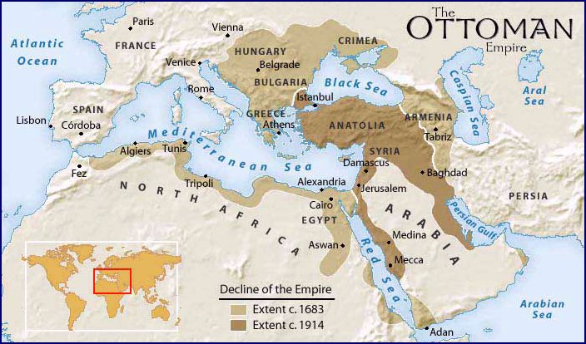

Slide 20
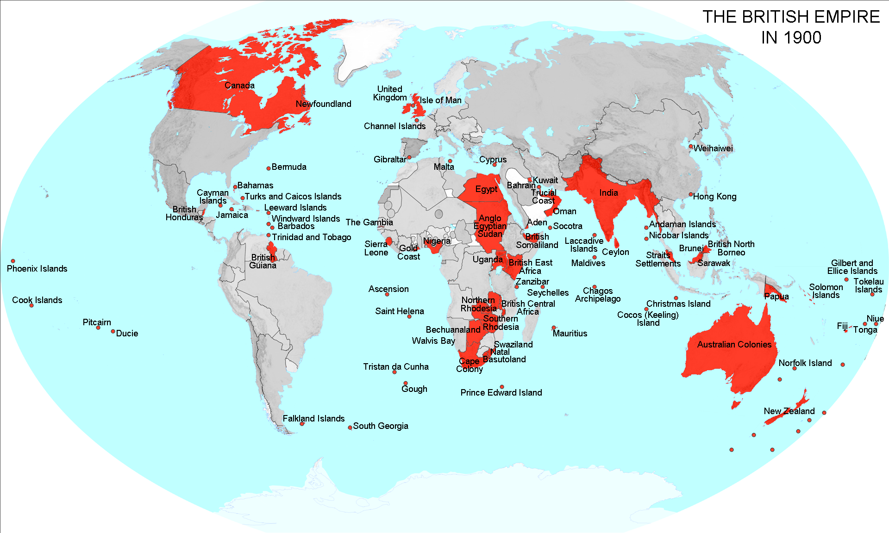

Slide 21
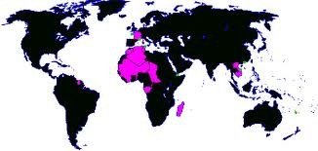

Slide 22
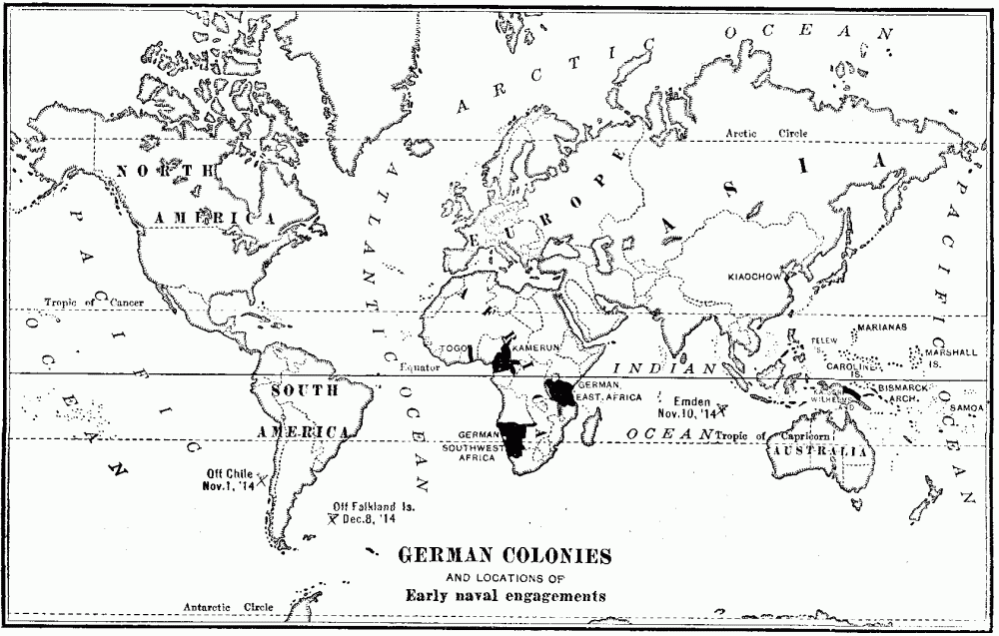

Slide 23
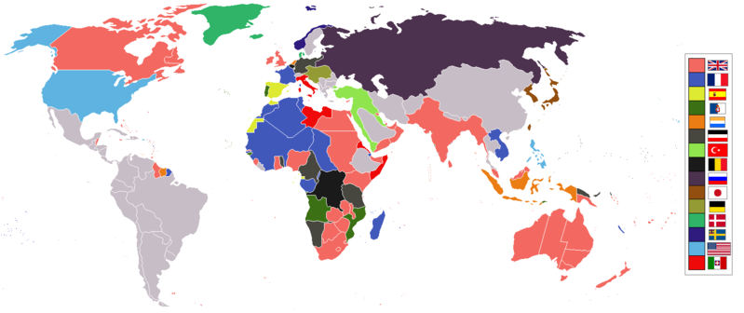

Slide 24
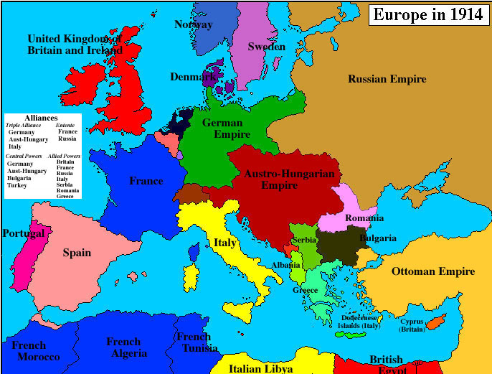

Slide 25
