Slide 1
American Intervention
WWI

Slide 2
Recap
Isms: Militarism, imperialism, nationalism,
Alliances
The Black Hand vs. Franz Ferdinand
A-H – Serbia, Russia – AH, Ger. – Russia/France, England – Ger.
1914-17.
Russia bails (Bolshevik Revolution)

Slide 3
USA
U-boat (Unterseeboot) – submerged vessel capable of surprise attacks on merchant/naval shipping. Undetectable. No warning, no mercy!
U-boat vs. blockade. Moral high ground?
Transatlantic cable – connects US to England, Germany, France. Communication.
England cuts cable from Germany to US.
War info solely comes from England.

Slide 4
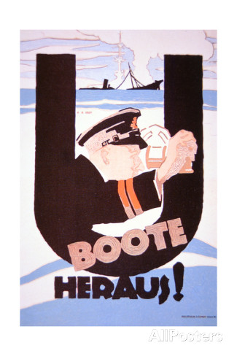
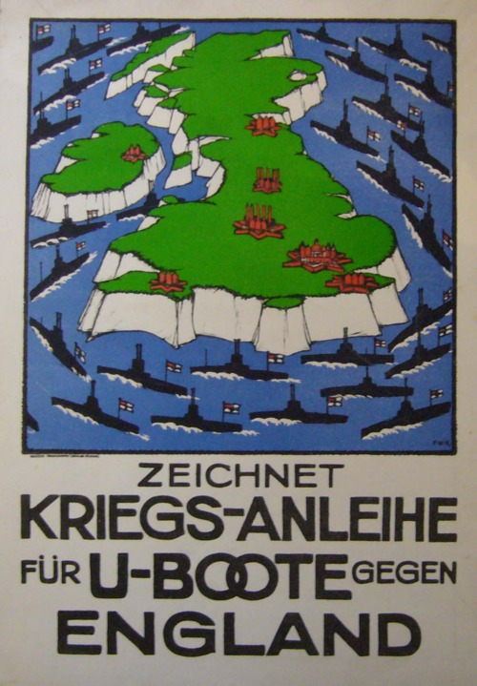

Slide 6
Ships
Lusitania – British passenger ship traveling (5/15) in the Irish Sea…with weapons from USA to England. Sunk. 1200 killed.
Yellow Journalism/Jingoism – “Frightfulness” and “Barbarism” used by the press. Accounts of children dying at sea.
President Woodrow Wilson demands that Germany warn ships before sinking.
Germany abides, provided the crew does not resist.

Slide 7
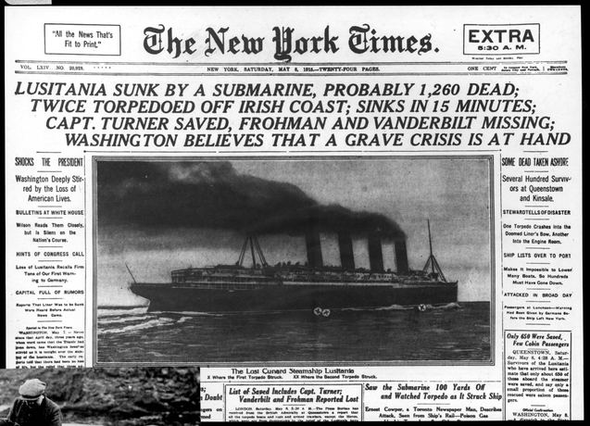

Slide 8
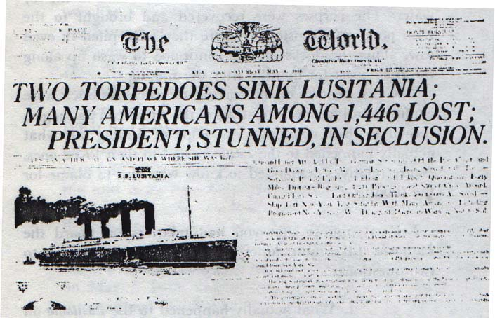

Slide 10
Sussex
French passenger ship, Sussex, sunk. No American deaths. Cross channel ship.
Wilson issues Sussex Pledge: Warn ships before sinking them or we will sever diplomatic ties with Germany.
Germany abandons submarine warfare around England.

Slide 11
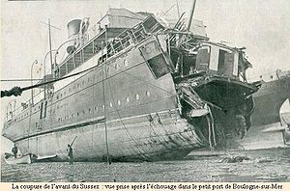

Slide 12
US Response
National Defense Act of 1916 – increases size of the armed forces (troop ceiling raised).
  Permits President Wilson to call up national guard for war purposes.
  Allows from US banks to loan money to allied powers.
Wilson re-elected in November, 1916 – “He kept us out of the war.”

Slide 13
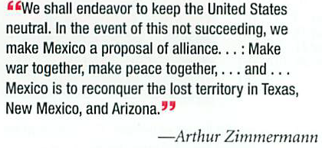
Zimmermann Note
British intercepted a communication from Arthur Zimmerman, Germany’s foreign secretary, to Mexico.

Slide 14
Declaration of War
Zimmermann Note – Yellow Journalism
3/1917 – Germany renews unrestricted u-boat warfare. City of Memphis, Illinois, Vigilancia sunk.
April 6, 1917 – US declares war on Germany.
“The world must be safe for democracy.”
American Expedition Force (AEF) formed (US Army in WWI)
“Doughboys” – nickname for US soldiers
General “Blackjack” Pershing commands US forces.

