Slide 1
Robber Barons
Captains of Industry

Slide 2
Modern Day
What defines a successful leader?
CEO – Chief Executive Officer.
What attributes would you look for when hiring a person to run your billion $$$ company?
Illinois Football Head Coach
Nice guy vs. successful guy, who ya got?
How much illegality would you tolerate? Play by the rules or renegade!!!!

Slide 3
RB or CoI
Captain of Industry – pioneer or revolutionary spirit that transforms a company into a leading entity.
  Raise productivity
  Expanding market share
  Job creators
Robber Baron – their who grew their company at the expense of the environment, worker or society.
  Drained natural resources
  Corrupt and caused corruption
  Ruthlessly drove competitors to ruin
  Maltreatment of workers

Slide 4
Andrew Carnegie
Born in Scotland in 1835. Immigrated in 1848.
Family was poor. Made $1.20/week in a cotton mill when he was 13.
Worked for PN RR Co. Making $50,000 by the time he was 30.
Bessemer Process – cheaply turn iron into steel.
Built steel plants to produce steel. Fortune.
Undercut rival’s steel prices, drove them out of business.
Bought iron mines, shipping and rail lines necessary for production.
Vertical consolidation – purchasing/controlling all steps in the production-sale of a product.

Slide 5
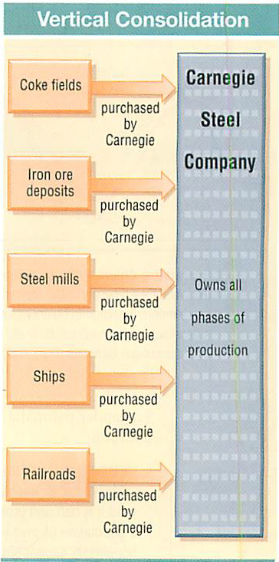

Slide 6
Philanthropist
Gospel of Wealth – make as much moolah as you can, but give it all away before you die.
Carnegie libraries, museums and other public venues.
Social Darwinism – based on Darwin’s theory of evolution, rich are better class of people because they earned/worked their way to the top.
  Government should not interfere with this process.
Laissez-faire Economics – no government interference in business practices, taxing profits or regulation of working conditions.
“Invisible hand” -- free market approach will ultimately decide good and bad practices.

Slide 7
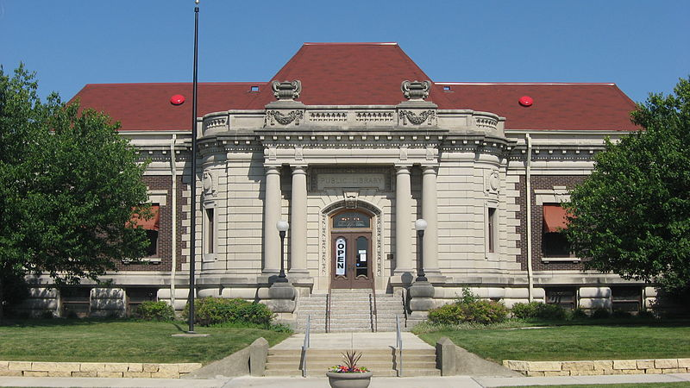
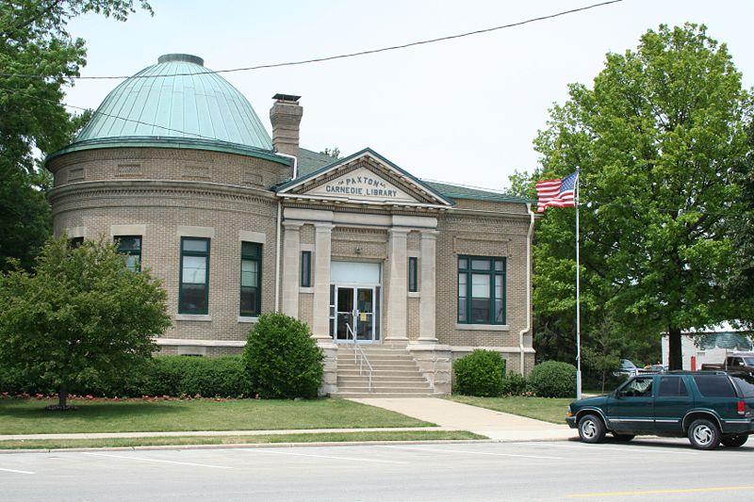
Carnegie Philanthropy

Slide 8
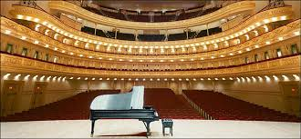
Carnegie Hall

Slide 9
John Rockefeller
Titusville, PN – oil is struck from the ground.
Opened first oil refinery in 1863, formed the Standard Oil Company of Ohio in 1870
Transported so much oil on the RR that he forced the RR’s to raise shipping costs on rivals while lower costs for his company. Drove others out of business
Bought competitors. Formed a monopoly, restricting free trade.
Horizontal consolidation – controlling the production, sale or distribution in the same business.
Board of Trustees – company run by # of guys who would turn profits over to…whoever.
Also known as a Trust. Numerous companies would be managed by a trust, but they wouldn’t merge.

Slide 10
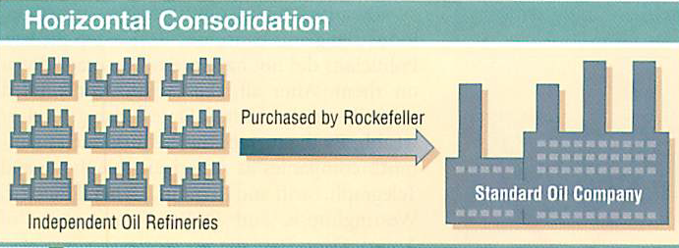

Slide 11
Competition
Increase profits
  Reduce costs
  Increase revenue
  Find new market
  Sell new products
  Diversify
Monopoly – sole control of production, distribution, or sale of a product
Cartel – small group of companies or owners conspire to control costs or prices of a product

Slide 12
Fin
Economies of scale – the more you produce the cheaper the cost.
Business cycle – boom and bust patter or consumer buying and not buying goods on the market.
What month(s) or period do Americans spend the most?
What month(s) do Americans spend the least?
Cycle: Expansion-Peak-Recession
Recession – contraction of the economy for 6+ months.
Depression – longer and deeper recession
“Panic” – moment or specific cause of a recession or depression.

Slide 14
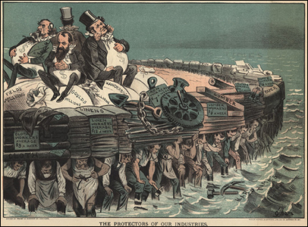
Muckraker

