Slide 1
England’s Colonization
Hi

Slide 2
The Demise of Spain
Privateers – Private ships that attack foreign ships, take their stuff, burn/capture ship.
Sir Francis Drake – “Sea Dog” favorite of Queen Elizabeth I, raids St. Augustine, FL plundering moolah. This is common.
Spain sends an armada to invade/destroy England’s gov in 1588. The armada is destroyed because of high winds (god’s doing) and smaller, navigable English ships.
Spain’s supremacy of the seas vanishes.
England is now free to really explore and settle.

Slide 3
Other Explorers
Amerigo Vespucci – Italian sailor explored central and south American coasts. 1st to believe this is a “new world,” and not Asia. Name look familiar?
Jacques Cartier – St. Lawrence River. Beginning of French presence in Canada.
Henry Hudson – Dutch/English explorer established trading outposts in New York
John Cabot – 1st explorer for England to cross the Atlantic. 2nd trip, never seen again.

Slide 4
Types of Colonies
Joint-Stock – investors pool money and send people to colonize an area. Profits are split. Virginia Company had a charter (contract) from the king to start VA.
Proprietary – one or more people granted land and authority to rule over that land
Royal – directly controlled by the king

Slide 5
Roanoke/Jamestown
1st attempted colony by England. Led by Walter Raleigh. Failed. No one knows what happened to the peeps.
Next shot, Jamestown, 1607, proved a better success.
Hardships/Problems
Gentlemen wouldn’t work
Environment (bugs, swamp, disease)
Poor leadership
Starving Time Winter 1609-10 (Cannibalism)
John Smith – He that will not work won’t eat.
By 1620, colony starts to thrive because…
John Rolfe – Tobacco cultivation.

Slide 6
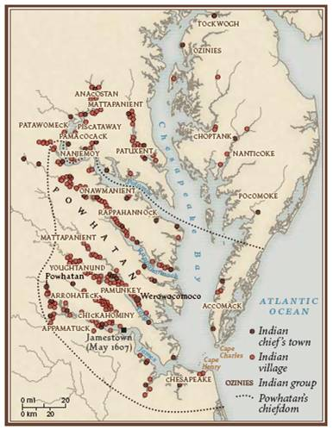
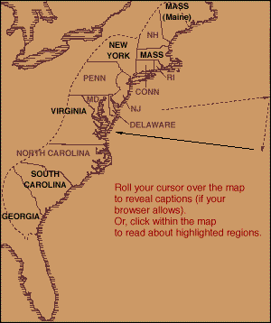
Powhatan Confederation

Slide 7
Tobacco and Labor
1616 – 2500 lbs sent to England
1618 – 50,000 lbs sent to England
1640 – 3,000,000 lbs sent to England
Indentured Servitude – Englishmen bind their lives to a farmer for 7 years. In return, ocean voyage paid for, and owner buys chunk of land for IS when contract is up.

Slide 8
New England
Plymouth Colony – Separatist Puritans landed in MA.
Mayflower Compact – governments are made up of men who rule by consent.
William Bradford – 1st gov. of Plymouth, governed for next 30 years
Massachusetts Bay – More Puritans come via the Great Migration.
GM – movement of thousands of Puritan families from Netherlands and England.

Slide 9
Tidbits
Religious community – Well-mannered and organized around town square. Spying on your neighbors is encouraged!
Fem Covert – Land owning dad is in charge of household (wife, kids, servants). Only one that can vote.
Predestination – Heaven/Hell already decided. You want to look like you’re one of the elite.
Capitalism – more stuff, more you look elite. More elite looking, more you think you’re heaven bound.

Slide 10
Problems
Salem-Witch Trials – lots of false accusations based on nada. Fear rules.
No religious tolerance. Anne Hutchinson kicked out for trying to interpret bible without permission from minister.
Native American Wars: Pequot, King Phillip’s war. Mass exterminations both ways. The need for British troops increases.

Slide 11
Middle/Southern Colonies
New York – Dutch first start “New Amsterdam” for trading. England’s Duke of York buys it from Dutch.
New Jersey – split off of NY, named after King’s bro’s friend’s home.
Pennsylvania – William Penn granted land by Charles II.
Quaker – starts Philadelphia, city of “brotherly love.”

Slide 12
Quakers
Find your inner light.
No sacraments, laymen, ceremonies
No churches. Meetinghouse is okay
Pacifists – no violence whatsoever.

Slide 13
Southern Colonies
MD – Lord Baltimore establishes a haven for Catholics. Maryland Toleration Act.
MD/VA – 1st imports of African slaves to work on tobacco plantations.
Carolinas – Rice plantations, ship building and supplies.
Georgia – James Oglethorpe made a haven for debtors/paupers in prison in England.
Single men settled the region.

