Slide 1
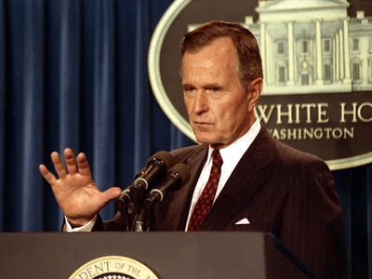
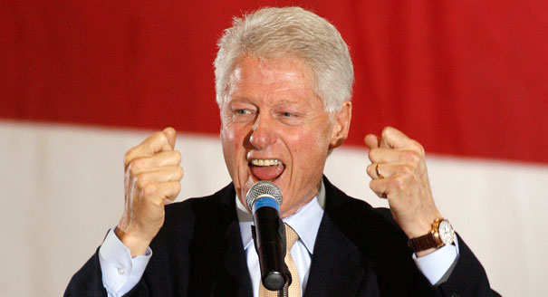
George H.W. Bush
And Bill Clinton

Slide 2
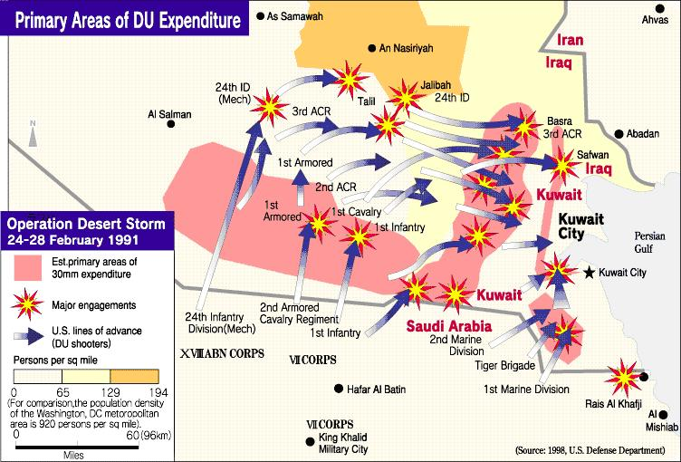

Slide 3
GW -- Background
Born in Massachusetts, 1924.
Raised in a religious family that valued hard work, dedication to family and country.
Served as a fighter pilot in WWII
Married after the war (anniversary was Tuesday, if it matters to you).
Moved to Texas to become an oil man. Made a fortune.
Unsuccessfully ran for the Senate (that means lost) in 1970, but was appointed a US Ambassador to the UN, eventually became the director of the CIA.
Ran for Republican nomination for POTUS in 1980, but lost out to Reagan. Joined Reagan’s ticket in 1980 (VP).
Defeated Michael Dukakis (Willie Horton Ad)

Slide 4
Domestic Policy
GHWB – carried over a number of people from the Reagan Administration, thus keeping the same ideas.
Budget – Federal debt in 1989 was $3 trillion, compared to today’s $17T.
No new federal programs or new spending.
Volunteerism
Education reform
“Read my lips: no new Taxes.”

Slide 5
Budget out of whack
Omnibus Budget Reconciliation Act – Raised highest income tax bracket to 31% (currently 39.6%). Raised motor fuel taxes. Created an excise tax on imported luxury items (yachts, luxury vehicles, jewelry and furs).
Americans with Disabilities Act (’90) – forbade discrimination based on disability (physical and mental) in the job place, transportation, education,
Clean Air Act (‘90) – Reduce smog; reduce acid rain causes; reduce emission of toxic chemicals. The ozone layer thanks you.
Considered a moderate republican president

Slide 6
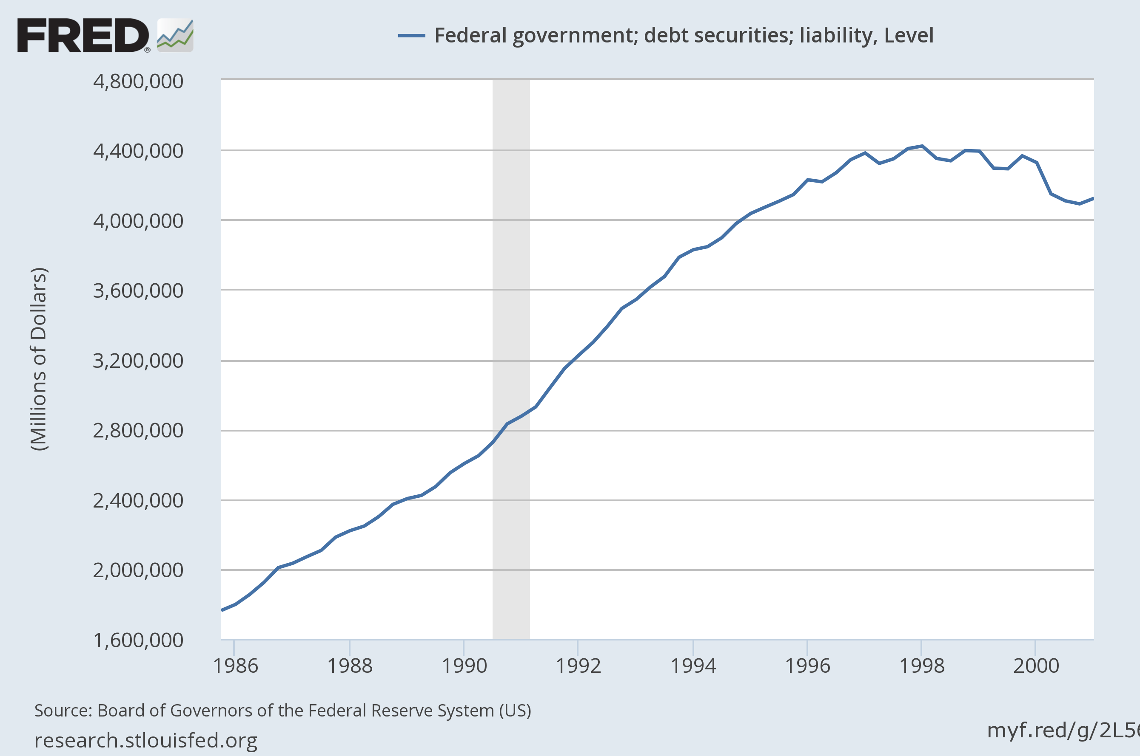

Slide 7
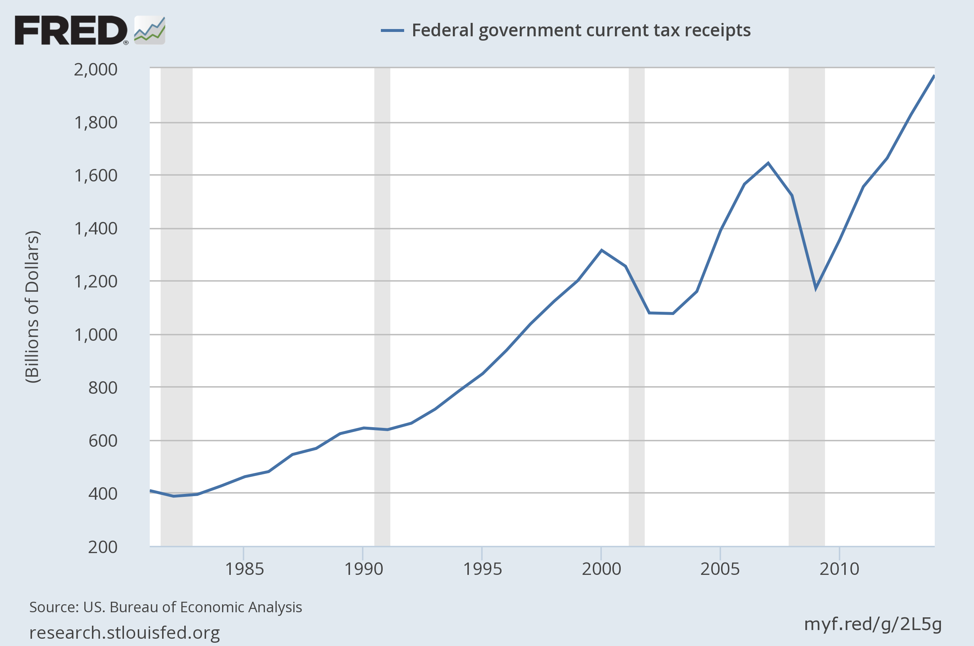

Slide 8
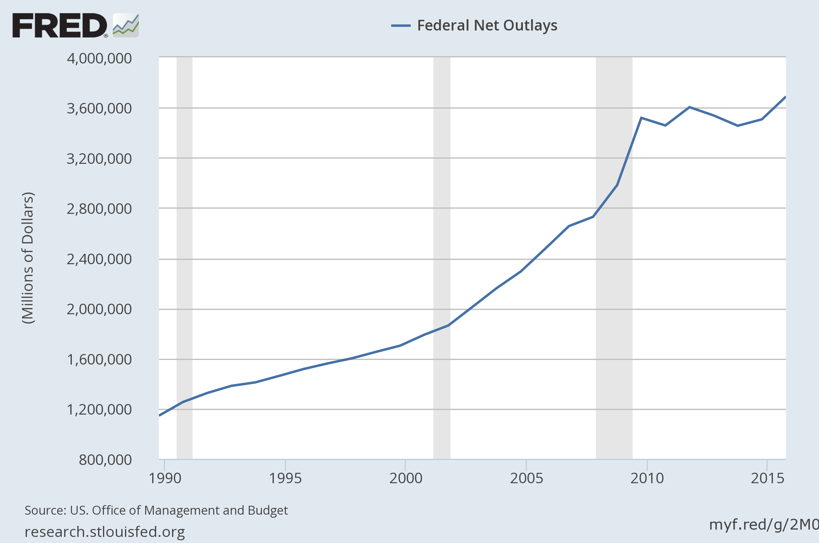

Slide 9
Foreign Affairs
China: 1989 Tiananmen Square. 100’s or 1000’s of people killed in a democratic protest in China. US Reaction? Nada. Didn’t want to sour improving Chinese/American relationship
Trade Balance with China
Panama. Remember stopping communism in the 3rd world? Korea, Vietnam, Afghanistan, Iran, etc.
Manuel Noriega: Pro-US “president” of Panama, who was a dictator. Lost his country’s democratic election, refused to vacate post. Dictator.
1 US serviceman killed in a fight with Panama’s military forces.
Operation Just Cause – US infiltrates Panama, captures Noriega. Brings him to the US. Why?
Running drugs...to the US!!!! Enemy of my enemy is my friend

Slide 10
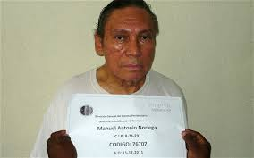

Slide 11
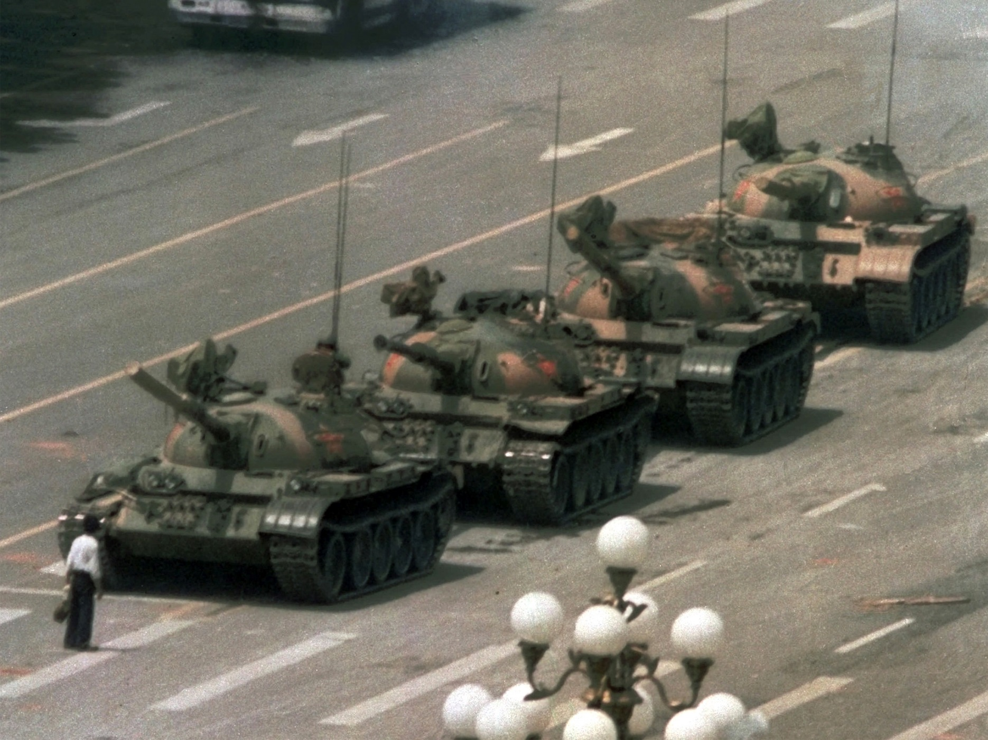

Slide 12
End of the Cold War
Fall of the Berlin Wall in 1989. President Bush doesn’t gloat. “I’m very pleased,” he says. But that’s basically it. Doesn’t want to anger the hardliners in Russia.
START – Strategic Arms Limitation Treaty – reduces the total nuclear warhead stockpile
GHWB cultivates relationships with Russians so when the fall of the Soviet Union occurs on December 25, 1991, the US is in good graces with the first freely elected president of Russia, Boris Yeltsin.

Slide 13
Persian Gulf War
Iranian Revolution (1979) – Iran goes from ally to enemy of the US. Need a balance in the region.
Iraq! US financially buys Saddam’s loyalty. Gives him weapons, chemical weapons, cash to hate Iran. Iran-Iraq War ensues from 1980-1988. 1,000,000 people killed.
UN brokered resolution stops the war.

Slide 14
Persian Gulf War
1990 – Saddam Hussein invades Kuwait. Believed it was destined to be a part of Iraq.
Bush calls world nations and the U.N. to rally support to remove Saddam from Kuwait
December, 1990 troops are in place in Saudi Arabia. Operation Desert Shield
January, 1991 Operation Desert Storm launched. 3 weeks later, Saddam gone from Kuwait.
Not captured, killed, beaten, removed from office.

