Slide 1
Immigration
Chapter 16

Slide 2
Reasons for Settlement
Improve standard of life
Escape persecution/prosecution
Escape plight
Financial: broke
Agricultural: lack of land
Famine: Irish Potato Famine (blight) wipeout of an ag crop
1860 Resident US Pop: ~30 million peeps
Immigration 1865-1920: 30 million peeps

Slide 3
Possibility
Industry: steam powered ships ease ocean transportation. 2-3 week voyage
Steerage: large open areas in the bowels of ships (think warehouse). Cheap but dirty way to travel
“Birds of Passage” – temporary workers who traveled to American, then returned home.
Immigration waves: resettlement from geographic areas of the world

Slide 4
Europe
Wave #1 (1860-1890ish): Irish, German, British (north/west/both Europe)
Wave #2 (1890-1920): Italy, Greece, Russia, Romania (Eastern Europe)
Office of the Superintendent of Immigration – federal office charged with who to let in and how many.
Eastern ports: Philly, Boston, New York (70%)
Ellis Island: 12 million
Western Ports: Seattle, San Francisco – Asian Immigrants (Japan and China)
Angel Island: 1 million

Slide 5
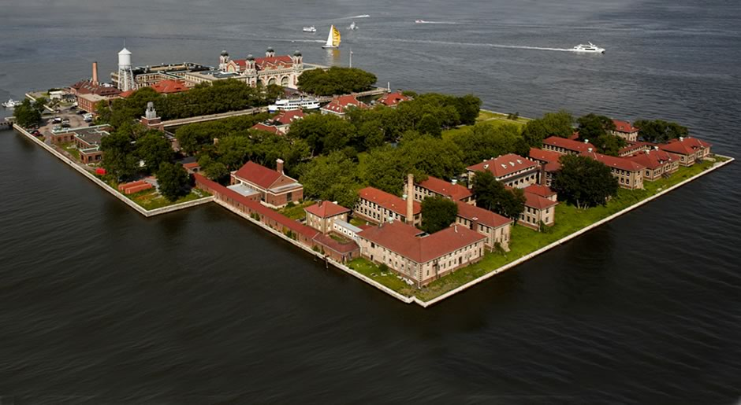
Ellis Island

Slide 6
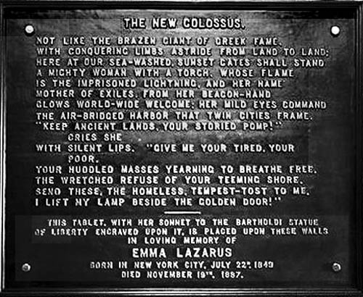
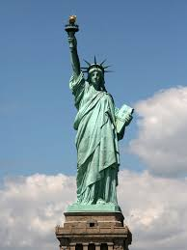
Statue of Liberty. The New Colossus

Slide 7
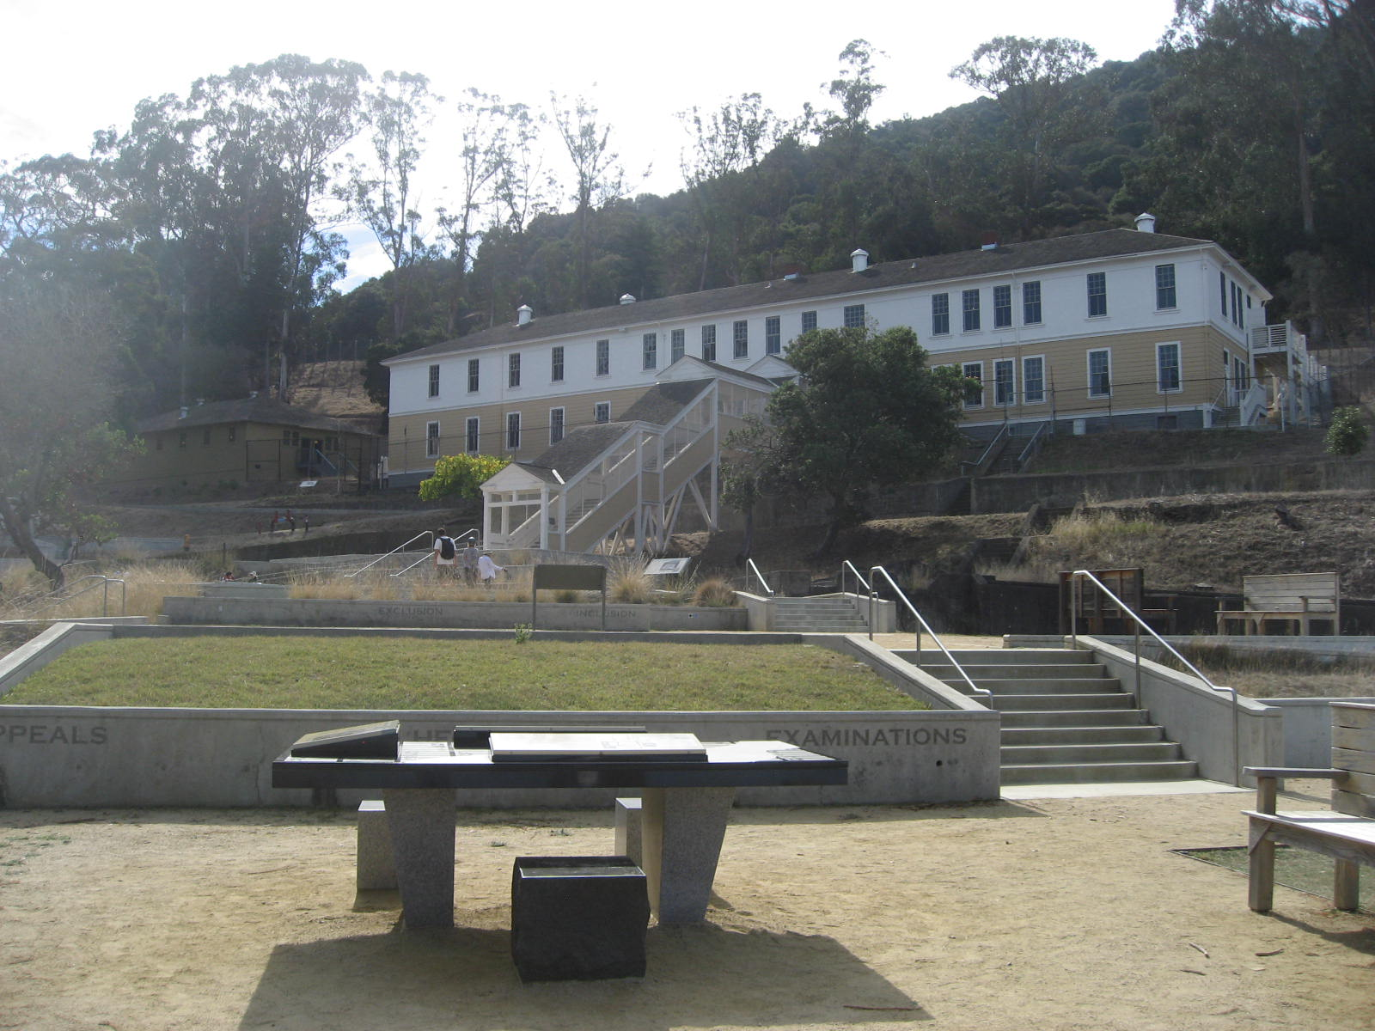
Angel Island

Slide 8
Design
Immigration Processing
Hospital/quarantine (isolation for sickness)
Detention and deportation
Processing
Name and country of origin
Physical examination
Background check (what questions?)
NY, NJ, Detained. 3-5 hours per immigrant. Welcome to the USA
21st Century Process

Slide 9
Settlement
Settled in neighborhoods where “your people” live. 98% live in the “north”
Ports
Industrial centers
Mining towns
Employers like immigration: low skills, low wages
Unions disapprove: take jobs away, scabs, work for low wages

Slide 10
Asia
Asians are culturally different from Europeans
Targets for suspicion
250,000 recruited for building railroads out west.
12,000 worked on the western branch of the Transcontinental RR
Settled, thrived, but not accepted by white Americans – “Chinatown”
Racism – Chinese Exclusion Act (1882) prohibited “new” Chinese laborers from China.

Slide 11
Continued
Japanese immigrants came via Hawaii (sugar plantation workers).
200,000 by 1920. Settled in Los Angeles.
Fruits/Vegetables farming and distribution
Entrepreneurs – didn’t compete with labor unions.
Segregation: Asians segregated from public schools.
Webb-Alien Land Law: banned noncitizen aliens from owning farmland.

