Slide 1
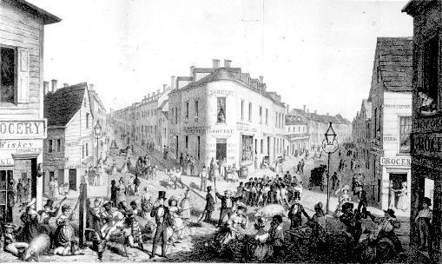
Industrialization and Daily Struggles

Slide 2
Recap
1 Captain of Industry wealth = 6 million people collective worth
Urbanization – changes in behaviors, mores
Mechanization
Transportation/communication revolution
Closing of the frontier
Corruption, greed and avarice
Social Darwinism
Gospel of Wealth

Slide 3
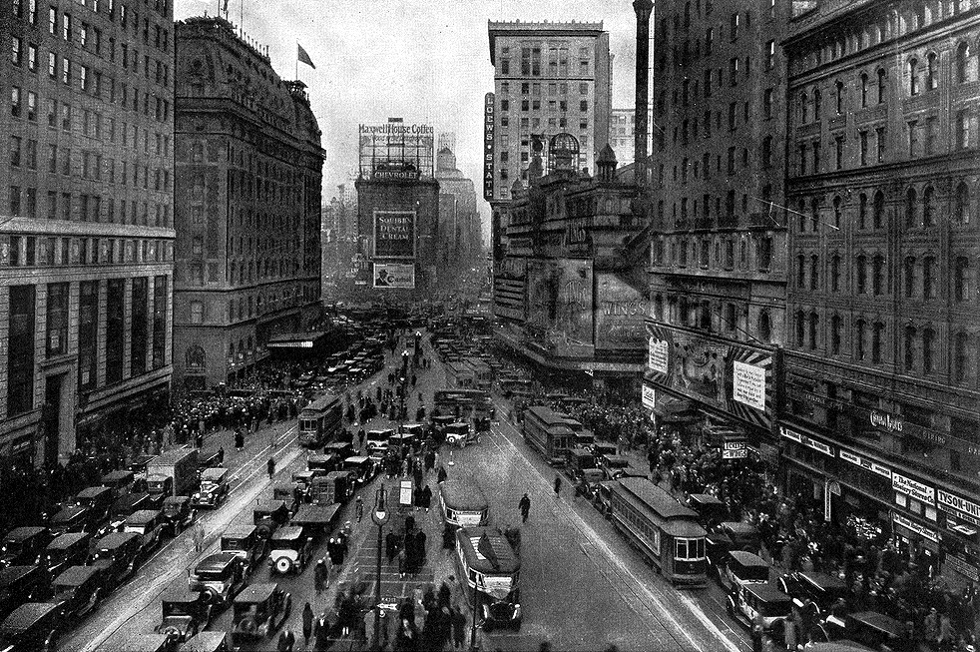
Times Square 1920

Slide 4
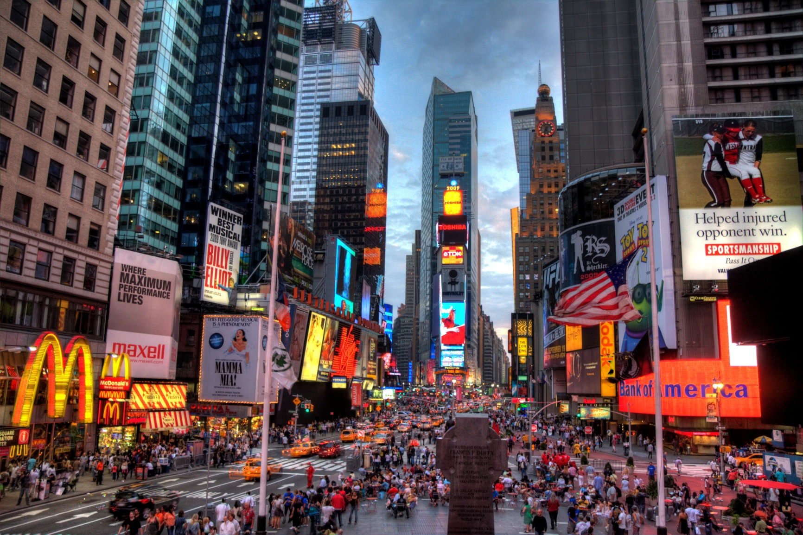
Times Square Summer 2013

Slide 5
The City
Need for farmhands shrank because of mechanization. Migrate to the cities.
Great Migration – African-Americans leaving the south and migrating to the north or west. Trend will not reverse until the 1990’s.
Factories produced clothes, steel, food for the population.
Cities grew from 3-4 miles across to dozen(s) of miles.
City transportation (cable car, horse carriage, elevated train, subway train, and car) allow for suburb (home away from city and work)
Separation of work and home.

Slide 6
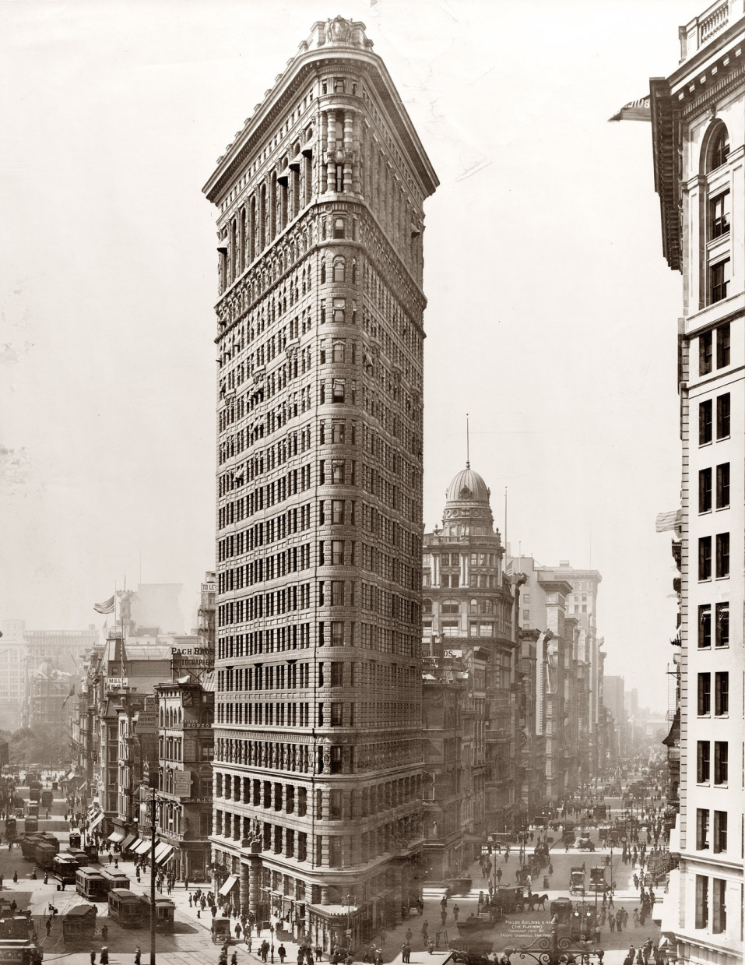
Flat Iron Building
Bessemer Steel – tall (skyscraper) possible
Elisha Otis – elevator
Specialized buildings/neighborhoods
Financial
Government
Department stores
Warehouses
Stockyards

Slide 7
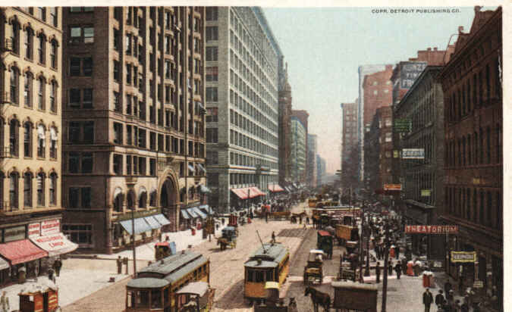
Chicago – State Street

Slide 8
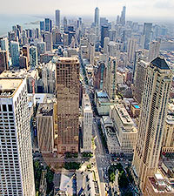
Chicago – Magnificent Mile

Slide 9
Housing
Private multiple family units = tenement housing.
Lots of poorly constructed/kept tenement housing is called a slum
Slum – no trees/grass (pavement), sewage problems, garbage collection problems (RATS!), air pollution from coal fireplaces.
No plan for fire. No regulations. No health inspector.
Fire (Chicago) and diseases (cholera, TB, malaria, typhoid)
Life expectancy in 1900 – 46(M)/48(W)
Life expectancy in 2013 – 76(M)/81(W): 26th in the world.
New York State Tenement Housing Act (1901) – Newly constructed housing must have outward facing windows, ventilation, indoor toilets

Slide 10
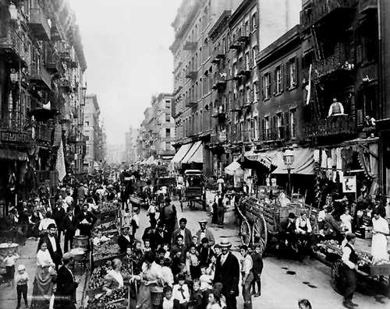
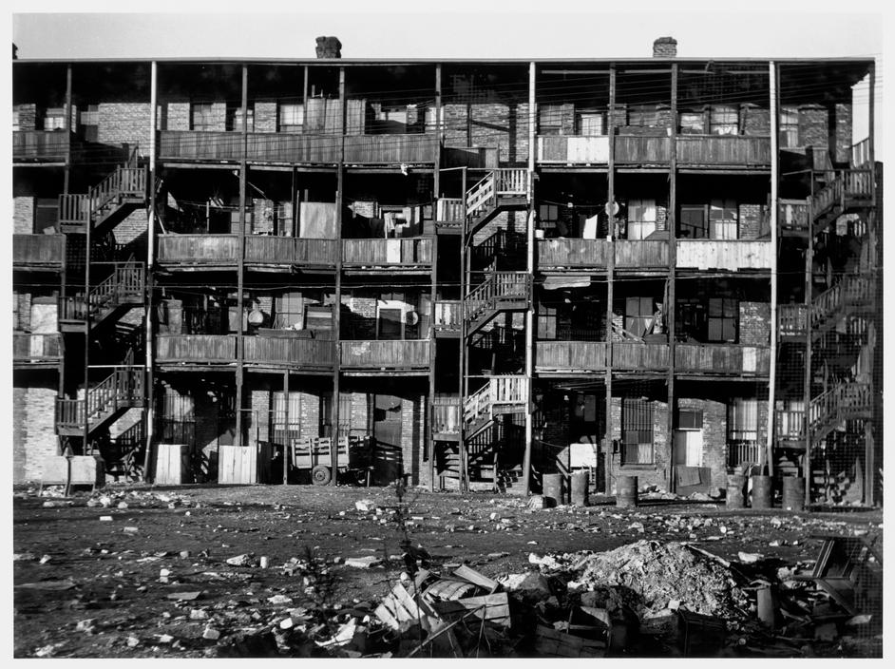
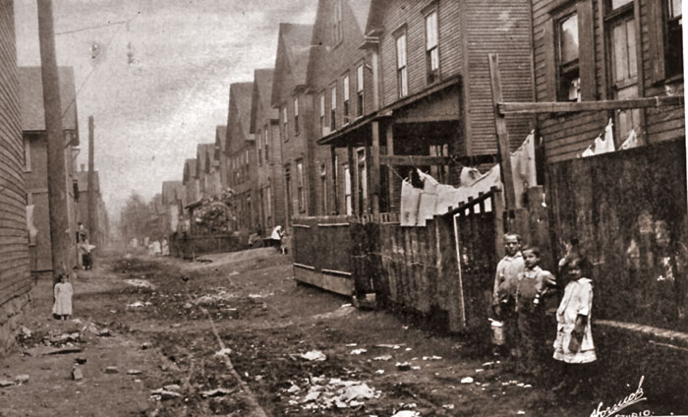
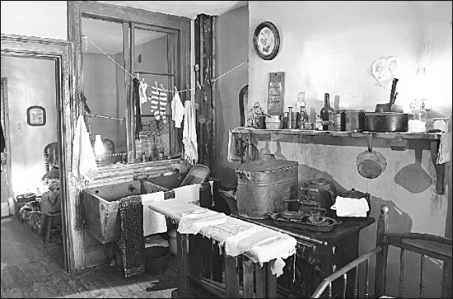
Tenement Housing/Market

Slide 11
Ghettos
Very old term. 16th century term. Used to describe Jewish quarter of a city.
Ghetto – specific area of a city’s population that is inhabited by a particular ethnic group.
Chinatown, Little Italy, Little Ireland, 5 points.
Restrictive covenants: agreements among homeowners not to sell outside of your ethnic group or race.
Gangs – bands of people from the neighborhood protecting the neighborhood.

Slide 12
Victorian America
Middle/upper class lifestyle differed.
Chicago’s “Gold Coast” offered larger apartments, greater access to parks/recreation. Electricity, plumbing, upscale businesses.
Domestication of the dog. Home companion. Cultivate things for personal leisure instead of necessary use.

Slide 13
Politics
Governments respond to rapid urban growth by establishing fire/police dept., sanitation districts, transportation networks.
More responsibility = more political power.
Political machines – unofficial city political organization (party/non-party) created to maintain power via corruption and bribery.
Boss – guy in charge of political machine
Graft – use of one’s political job to gain profit
William Tweed (Boss Tweed) ran New York City’s Tammany Hall political club that padded bills, falsified receipts to illegally profit from taxpayer money.
2014 Olympics

