Slide 1
Japan

Slide 2
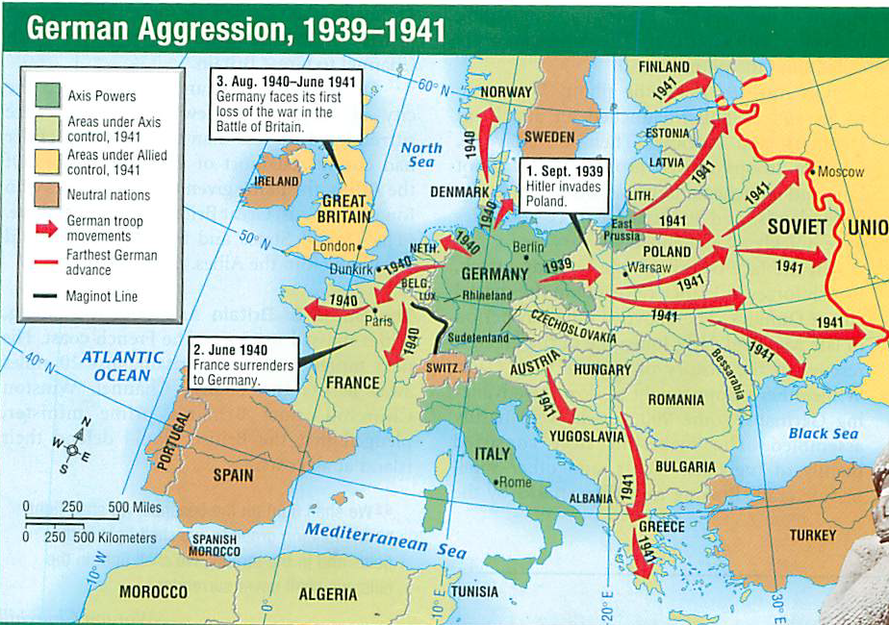

Slide 3
Remember…
Commodore Matthew Perry – “Opening of Japan” 1853-54
Meiji Restoration – Era of westernization and industrialization for the social and economic structures in Japan.
Political restoration of the emperor’s control over the government.
1920’s – Japan expands territorial conquests in pursuit of natural resources
Manchuria: 1931
East China: 1937-1940
Signs Tripartite Act in 1940 (Berlin-Rome-Tokyo Axis)
Neutrality pact with Russia in 1941

Slide 4
US
Navy transferred from San Diego to Pearl Harbor, Hawaii (1939).
Americans are isolationists (WWI)
Great Depression in America
WWII begins, US Gov issues “cash and carry” policy – goods bought by anyone must be paid in cash (gold) and transferred by purchaser.
Neutrality Act of 1939 – WWII? No thanks.

Slide 5
But…
Lend-Lease Act (3/1941) – President may aid any country’s well-being that is vital to US interests and national security
Good Neighbor Policy – neighbor’s house on fire, you lend him a hose. US loans goods to England.
FDR: US is “the great arsenal of democracy”
Meanwhile, Japan demands French colonies in southeast Asia (Indochina).
US freezes Japanese economic assets in America.
Tension increases.

Slide 6
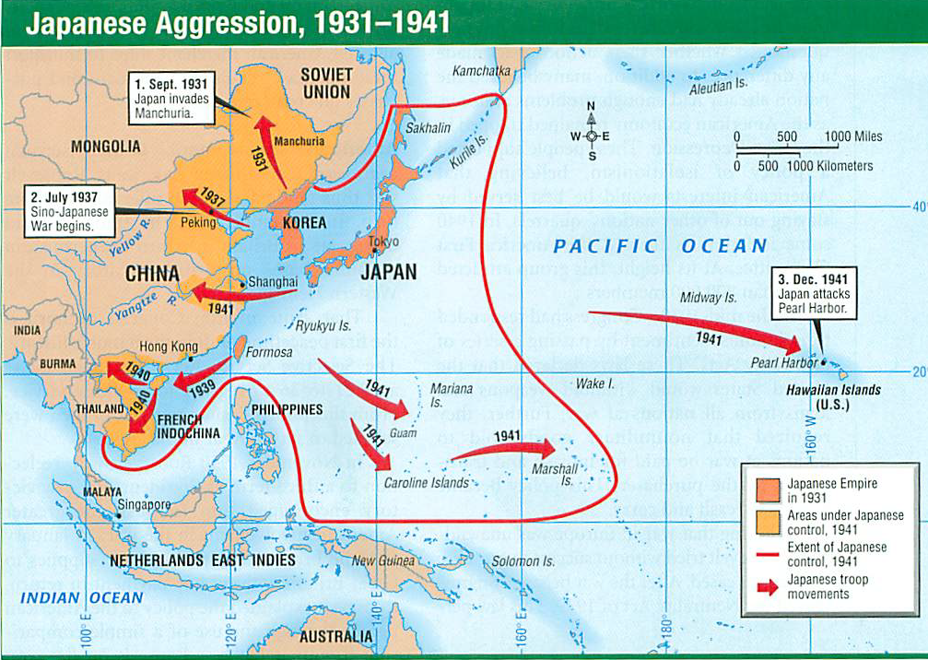

Slide 7
Magic Machine
Communication is done in code.
Magic – and Enigma (Germany) – machines broke the code. US intercepts messages. Knows of mass movement of forces.
US uses Navaho Code Talkers.
General Hideki Tojo (eventual Prime Minister of Japan 1941-44) advocated war with US
Japan has 2 fleets: one heads toward SE Asia (we knew about this one), another heads toward Hawaii (didn’t know this one).
US demands Japan stops 1st fleet and that they leave Tripartite Pact. Pearl Harbor was response.

Slide 8
Pearl Harbor 12-7-1941
7:48 am attack on a Sunday morning.
Radar man ignores large blips of planes
Base went on alert dozens of times before (boy who cried wolf).
Japan: 6 carriers, 300+ airplanes (torpedo and bombers).
US: 8 battleships damaged (4 sunk), 300+ planes destroyed, 2400 killed/1200 wounded.
Japan lost 20-30 planes.
“A date which will live in infamy.”

Slide 9
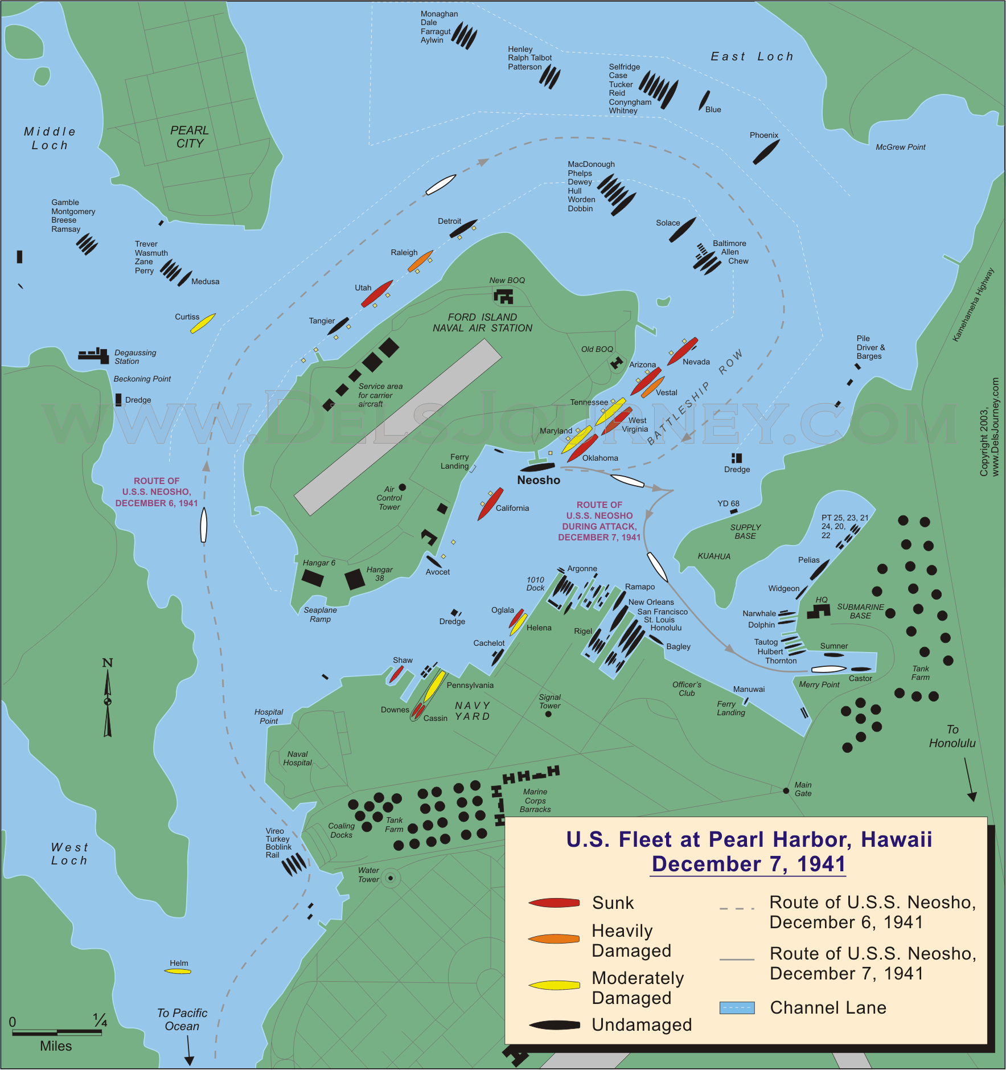

Slide 10
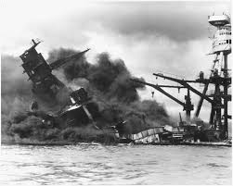
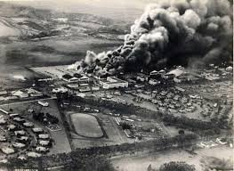
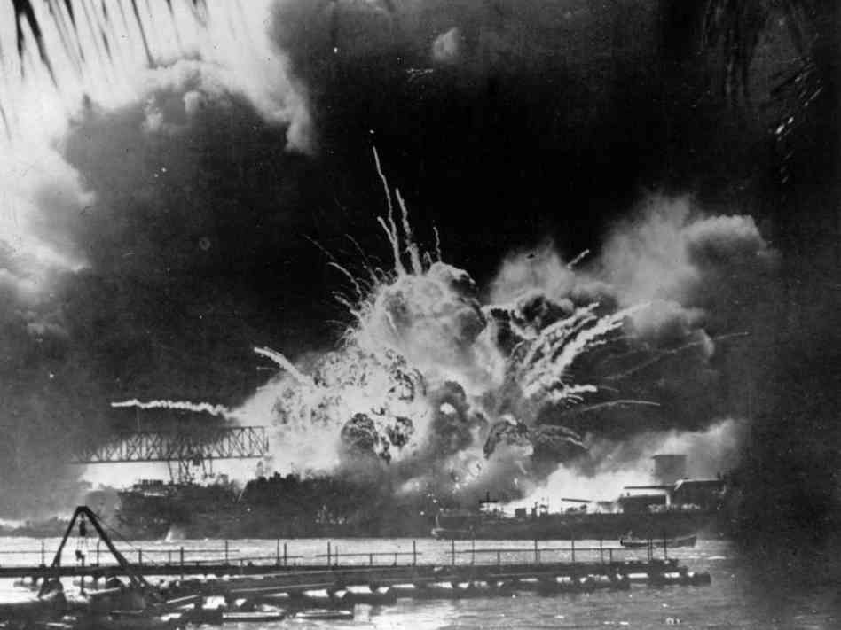
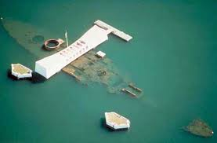

Slide 11
WWII
We declare war on Japan 12-8-1941. 388-1
Italy and Germany Declare war on US 12-11.
We declare war back same day.
Hitler blames us for starting WWII
Hitler blames the Jews for advising (controlling?) FDR’s foreign policy with Japan.
Hitler blames FDR for destroying Germany and Italian property.
US are war mongers who violate international law.

Slide 12
War in Pacific
Defensive strategy. Focus of materials goes to Europe
Philippines are conquered by Japanese by March, 1942.
General Douglas MacArthur left 11,000 Americans and 50,000 Philippine soldiers to the Japanese.
Bataan Death March – 60 mile forced march with little water or food. 10,000+ American/Phil soldiers died.
US did not learn about the forced march until 1945. Prisoners escaped.

Slide 13
Timeline
April, 1942 – Doolittle Raid. Colonel James Doolittle leads 16 light bombers over Tokyo. Little damage, big morale boost.
May, 1942 – Battle of the Coral Sea. Naval engagement with aircraft only.
War is to be an aircraft carrier based war.
US loses 2, Japan loses 2. Japan is at its furthest extent in the war.
June, 1942 – Battle of Midway Islands. Japan loses 4 aircraft carriers.
Japan is now fighting a defensive war.

Slide 14
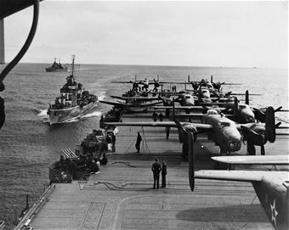

Slide 15
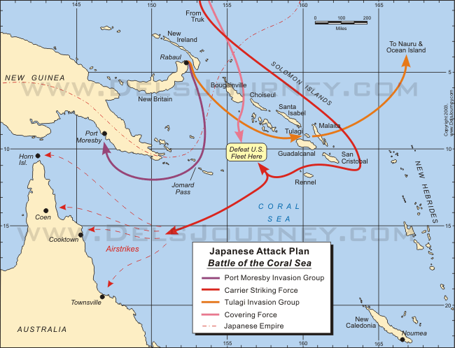

Slide 16
US Offensive
Guadalcanal – 8/42 to 2/43. Slow, slog through the jungle. Typical island warfare.
Gain an important base (airstrip) in the region.
Island hopping – US takes important islands, ignores most Japanese held islands. Skip.
Capture of Iwo Jima, Okinawa allow (1944) US to bomb Japanese Island cities.
Kamikazes (divine wind) attacks on US ships and personnel.
Banzai Charges – Japanese suicide missions.
Iwo Jima: Japan has 22K soldiers, 200 surrender.
Okinawa: Japan has 100K soldiers, 7,000 surrender

Slide 17
Manhattan Project
1939 – Einstein (pacifist) encourages FDR to build an atomic bomb before the Germans.
Top secret military/scientific mission to build an atomic bomb.
1st – attain nuclear fission (split atom)
Enrico Fermi (left Italy)
2nd – control nuclear fission
Robert Oppenheimer directed the project

Slide 18
The decision
Japanese homeland defense consisted of:
2 million troops
10,000 various aircraft
Civilian training
Iwo Jima and Okinawa
US estimates are 100,000 US soldiers killed, 300,000 wounded trying to take the islands.

Slide 19
The End
Hiroshima (August 6, 1945) – upwards of 140,000 people killed by the blast, fire, radiation.
Nagasaki (August 9, 1945) – 2nd bomb dropped. 70,000+ killed.
August 14, 1945 – Japan surrenders. VJ (Victory over Japan) Day is August 15.
September 2, 1945 – Japan formally surrenders aboard the USS Missouri.

Slide 20
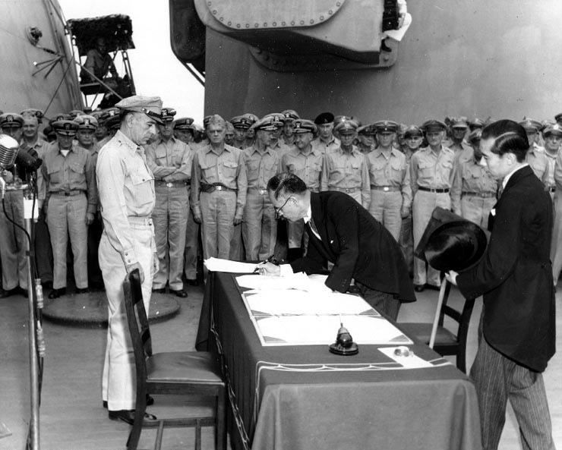

Slide 21
