Slide 1
Marshall Plan

Slide 2
Recap
Cold War
Yalta & Potsdam Conferences
Iron Curtain
Containment
Truman Doctrine
Primary Sources due tomorrow

Slide 3
Western Europe
21 million people homeless
Industrial, agricultural, infrastructure destroyed
Steel, tractors, crops, livestock
France – destruction = 3x national GDP
Poverty leads to desperation (socialism????)
Secretary of State, George C. Marshall, proposes a European Recovery Plan (Marshall Plan) in 1947
$17 billion or 7% of federal budget (48-52)
17 countries participated: Austria, Belgium, Denmark, France, Greece, Iceland, Ireland, Italy, Luxembourg, the Netherlands, Switzerland, Norway, Portugal, Sweden, Turkey, United Kingdom, and West Germany.

Slide 4
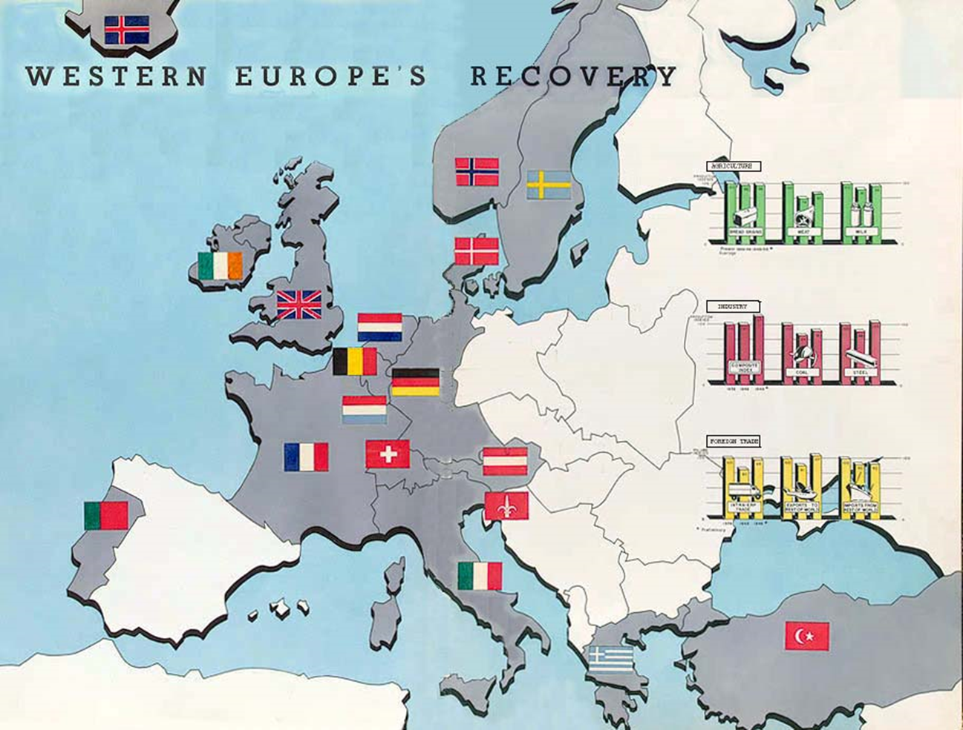

Slide 5
Results
US post—WWII economic depression did not happen.
Europe recovers economically
US-Europe economic ties created
Pro-US democratic governments elected in Western Europe.
Foundation for NATO
North Atlantic Treaty Organization

Slide 6
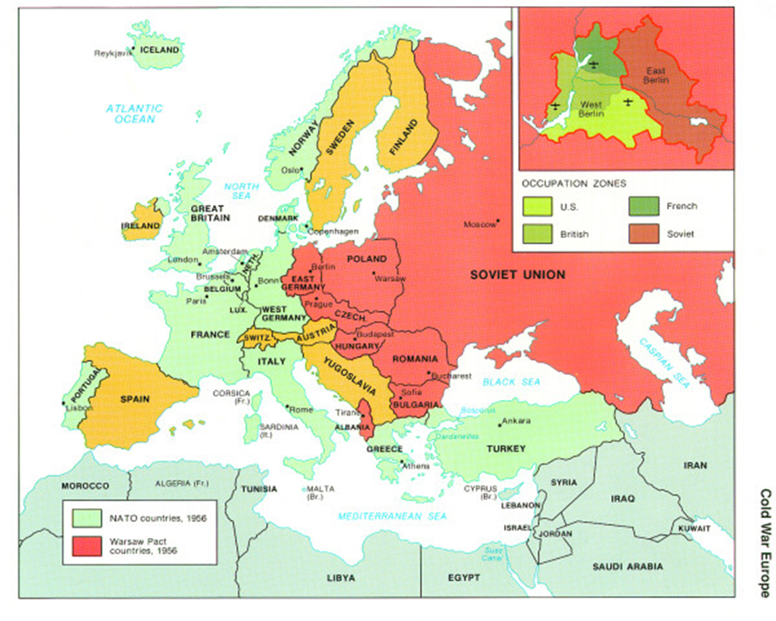
Berlin

Slide 7
Berlin Airlift
1st showdown between US & USSR
US, Eng, FR united controlled zones in W. Berlin.
Berlin divided into E. Berlin (Soviet) and W. Berlin (US)
Stalin refused German reunification of Berlin and Germany.
W. Berlin is a beacon for refugees from all over Eastern Europe. Escape to W. Berlin is like fleeing to the US.
Stalin demands US leave W. Berlin. Soviet military occupies/shuts road, rail and water transportation into W. Berlin

Slide 8
Berlin Airlift
From June, 1948 to May, 1950 some 200,000 flights carrying millions of tons of supplies to W. Berlin
Flights landing/taking off every few minutes.
Only way for Stalin to halt the airlift is shoot down the planes. That will lead to war.
US has atomic bomb, Soviets do not.
Stalin lifts the blockade.

Slide 9
Collective Security
Berlin Airlift necessitates an alliance between US and West Europe.
April, 1949 – Canada, US, Belgium, Britain, Denmark, France, Iceland, Italy, Luxembourg, the Netherlands, Norway, and Portugal form NATO.
Collective Security – an attack on one is an attack on all. Peacetime/wartime alliance.
First peacetime military alliance in US history
Abandon the Monroe Doctrine.
Soviets form the Warsaw Pact: USSR, Albania, Bulgaria, Czechoslovakia, East Germany, Hungary, Poland, Romania.

Slide 10
1949
Soviets successfully detonate an atomic bomb.
Both sides now capable of mass destruction.
Response:
US develops the Hydrogen Bomb (10x+ more powerful)
Federal Civil Defense Administration
Duck and Cover. Survive an attack
Chinese civil war gets settled: Mao Zedong (communist) defeats Jiang Jieshi (nationalist – US ally). US gave billions in military support to Jiang Jieshi. All lost.
Nationalists flee to Taiwan (Formosa).
Peoples Republic of China created.
US losing the war against communism.

