Slide 1
Origins of the Cold War

Slide 2
The Big Three
Joe Stalin – Premier (leader) of USSR
Franklin Roosevelt – POTUS
Winston Churchill – Prime Minister of England
1945 – Yalta Conference (February, 1945)
Creation of the United Nations
Divided Germany in half. East – USSR West – US, Eng, FR.
Poland is to be a post-WWII democracy
April, 1945 – FDR dies

Slide 3
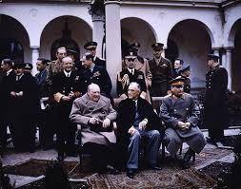
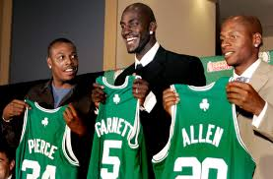
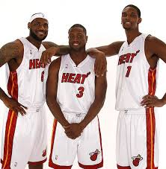
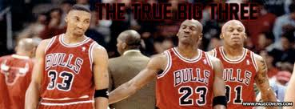
The Big Three

Slide 4
Potsdam Conference – July, 1945
President Harry S. Truman – “Give ‘em Hell Harry” was VP for 83 days, not included in FDR’s affairs as pres.
Potsdam (Berlin) issues:
German reparations to USSR
Poland’s independence
Truman informs Stalin of a successful detonation of an Atomic Bomb
“Use it wisely” was the response.
Relationship fracturing

Slide 5
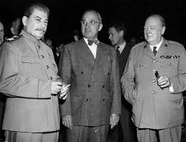
Potsdam

Slide 6
Cold War
Cold War – ideological fight between US and USSR over political, economic, and social differences. Competing ideologies.
Proxy War – letting smaller militaries fight out the Cold War issues.
Fall of 1945 – USSR occupies Eastern Europe. Establishes “satellite nations”
Satellite Nations – countries subject to Soviet domination: Poland, Bulgaria, Romania, Czechoslovakia, and East Germany.

Slide 7
Cold War Policy
Long Telegram (Feb, 1946) – George Kennan (US Ambassador in Russia) advises HST to take a hard line approach to Stalin.
Soviets have no intention of coexisting with capitalist countries. – “X” Article.
Containment policy – E. Europe is lost, but keep Soviet influence (communism) from spreading elsewhere.
Iron Curtain speech (March, 1946 – Churchill speech condemning the Soviet domination of Eastern Europe. Division.
Truman Doctrine (March, 1947) -- $400 million to countries struggling in their opposition to communist influences in their countries. Greece and Turkey are 1st recipients.
THE Cold War policy for most of the era.

Slide 8
