Slide 1
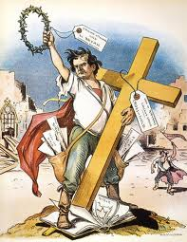
Populism and Progressives

Slide 2
3rd Parties
Ron Paul – Libertarian
Ralph Nader – Green Party
Ross Perot – Reform Party
George Wallace – American Independent Party
Strom Thurmond – Dixiecrats
Robert La Follette – Progressive Party
Teddy Roosevelt – Bull-Moose Party
William Jennings Bryan – Populist Party

Slide 3
Populism – The People’s Party
Made up almost entirely of farmers from the agricultural states.
Born out of economic depressions 1880’s and 1890’s. Low agricultural prices hurt farmers’ incomes.
Blame railroads, grain-elevators, lenders.
Platform: silver standard, direct election of senators, progressive income tax, public works
William Jennings Bryan – 3x ran for pres, 3x he lost.
Cross of Gold Speech: gold standard should be abolished because it’s killing farmers economically.

Slide 4
TR

Slide 5
Teddy Roosevelt
VP – William McKinley in 1900. McKinley assassinated. TR = president
Bully Pulpit – Use of political popularity as president to push agenda.
United Coal Workers Strike (1902)
Square Deal – workers get raise, work 1 hour less, business gets no union pledge.
Fair treatment for labor, business and consumers, government (square).

Slide 6
FDA
The Jungle
Meat Inspection Act – inspect meat processing plants. Make sure they are safe/clean.
Pure Food and Drug Act – creates FDA (Food and Drug Adm.)

Slide 7
Holding Company
Holding company – big corporation that owns little corporations = one big monopoly.
Supreme Court upholds Sherman anti-trust act against Northern Securities Company (a RR trust that owned railroads in northwest US
TR becomes known as a “trust-buster”
Files 40+ anti-trust actions as president
Establishes Department of Labor to represent laborers.

Slide 8
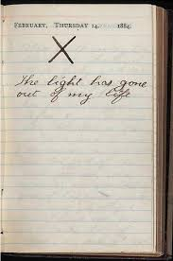
Conservationists
TR’s wife/mother die the same day.
Heads west to nature to clear his head.
National Park Service (1916)
Yosemite NP is first national park
As pres., passes Newland Reclamation Act – Irrigation system for western states.

Slide 9
End of Progressive Era
WWI marked the end of progressive reforms.
  Exception of 19th Amendment
Labor protections begin
Regulation of housing, working conditions, child labor, consumer products begin
Prejudice/racism not dealt with until 1965
Poverty is addressed, but not central focus
Back and forth on poverty and progressive issues

