Slide 1
Progressive Vantage POV
Girls

Slide 2
Quick Recap
Gov/Econ Issues: political/corporate corruption
Social Issues: temperance, poverty, civil rights
Captains vs. Labor Unions
Urbanization: slums and Victorian America

Slide 3
Issues
Nativism – favoring of American born over foreign born
Chinese Exclusion act
Immigration Restriction League
Prohibition – Temperance Movement. Abolish creation, distribution, selling of all alcohol
Prohibition Party. 18th Amendment.
Purity Crusaders: moralists who use law to enforce codes of behavior on society.

Slide 4
Social Gospel Movement
Private charities practicing the biblical notion of caring for the poor, sick and disenfranchised
Settlement House – shelter and basic educational practices to provide an income (mini-parkland colleges).
Jane Adams – Hull House in Chicago.
Provide childcare so parents could go to work
Lessons for immigrants (English)
Skill lessons (sowing, carpentry)
Health-care clinics
First playground. Summer camps for kids.

Slide 5
Education
John Dewey: Pragmatism (do what works).
Public schools should created to teach civic virtues and to train students in liberal arts and sciences.
Citizen training.
1900 – 32 states required schooling for children between 8-14.
1910 – 60% of all children (8-17) attending public school.
Assimilation of immigrants to American life.
Americanization of immigrants.
Private schools and segregated schools.

Slide 6
Prejudice
Women and college – unmarriageable. Too smart.
African-Americans, Asians, Hispanics – denied because of race.
Oberlin College (OH) – early college that offered co-ed education (men and women) and didn’t segregate non-white populations.
Booker T. Washington – freed slave who founded Tuskegee Institute. Focus was economic security gained from an education. Civil Rights was not stressed.
W.E.B Du Bois – Niagara Movement. Full integration in society. Counted Booker Washington’s segregation ideas.

Slide 7
Discrimination
Jim Crow – system of formal and informal “codes” dictating African-American life.
Poll Tax or Literacy Tests to A-A voters.
Segregation.
Plessy v. Feguson – Supreme Court decision that legalized private citizens to treat anyone as “separate but equal”.
Segregation is legal provided the alternative is equal.
Lynching – mob action. Vigilante justice for breaking the rules. Outside of court jurisdiction.

Slide 8
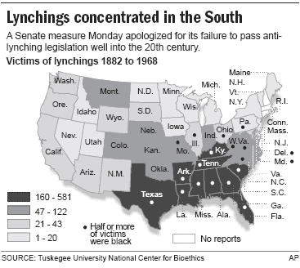
Lynching in America

Slide 9
Counter
Henry Turner – “Back to Africa” movement.
Booker T. Washington – education and economic prosperity.
WEB Du Bois – fight discrimination
National Association for the Advancement of Colored People (NAACP) founded in 1909
Young Men’s and Young Women’s Christian Associations (YMCA or YWCA)

Slide 10
“the woman question”
Women should be able to…
Vote
Control property and income
Equal access to higher education and professional jobs
Technology freed up time for more chores and responsibilities at home: piecework wage earners.
Full-time wage earners outside the home. Paid less then men.
Stereotype: women don’t have work ethic or mental capacity for work.

Slide 11
Right to vote
Seneca Falls Convention – NY meeting in 1848 regarding women’s legal standing in society.
Elizabeth Stanton and Lucretia Mott
Susan B. Anthony and Stanton fought for suffrage
Suffrage – the right to vote.
19th Amendment.

