Slide 1
The Holocaust
Hebrew – Shoah

Slide 2
Overview
Two meanings:
Destruction of the Jewish people by the Nazi’s
Destruction of cultures by the Nazi’s
Cultures Targeted
Jews
Polish
Russian
Romanian
Other targets
Physically/Mentally disabled
Homosexuals
Political opponents
Religious groups
Anywhere from 11-17 million killed in concentration camp, killing center, or otherwise outside the scope of “battle conditions”.

Slide 3
History of Jewish Persecution
Christian Persecution – Blamed for murdering Jesus. Crusades, inquisitions, expulsions, massacres throughout Europe for 1700 years.
4th Lateran Council, Canon 68: Jews and Muslims must wear clothing to separate themselves from Christians
The Black Death of the 14th Century
Wiener Gesera: Destruction of Vienna Jews in 1421
Mellah – walled cities in the Arab world for Jews.
Ghetto – walled cities in Europe, first located in Italy, for confinement of Jews
Pogrom (Rus: Devastation): systematic destruction of Jewish peoples in Russia, Ukraine, Poland in 19th and 20th centuries.

Slide 4
Germany
Hitler takes power in 1933.
Calls for immediate economic boycott of Jewish businesses and professions.
Adolf Hitler, Mein Kampf --
“Here he stops at nothing, and in his vileness he becomes so gigantic that no one need be surprised if among our people the personification of the devil as the symbol of all evil assumes the living shape of the Jew.”
Strips all Jews of civil service (gov) positions, farm ownership, education jobs.

Slide 5
Nuremberg Laws
Series of laws removing legal citizenship rights of Jews
Reich Citizenship Law – Sets the stage for who is a citizen of Germany
Law for the Protection of German Blood and Honor – forbade sexual relations and most work relations between Jews and non-Jews.
First Executive Order on the Reich Citizenship Law – legally clarified who is of Jewish ancestry.
Purpose of these laws was to create a Judenrein (free of Jews) Germany.
Evian Conference (1935) 32 Foreign countries refused to increase permitted Jewish immigration into their countries (except the Dominican Republic).
Wagner-Rogers Refugee Act: US allows 20,000 Jewish children in addition to the regular quota of Jews in the United States. Voted down in committee.
White Paper of 1939: Britain reduces immigration quota to Palestine to 10,000 Jews a year.
What country in the world had no restriction on Jewish immigration?
China
200,000 Jews emigrated from Germany by 1938. 1/4.
http://pages.uoregon.edu/dluebke/Holocaust444-544/Rassengesetz.html

Slide 6
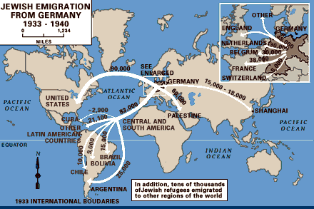

Slide 7
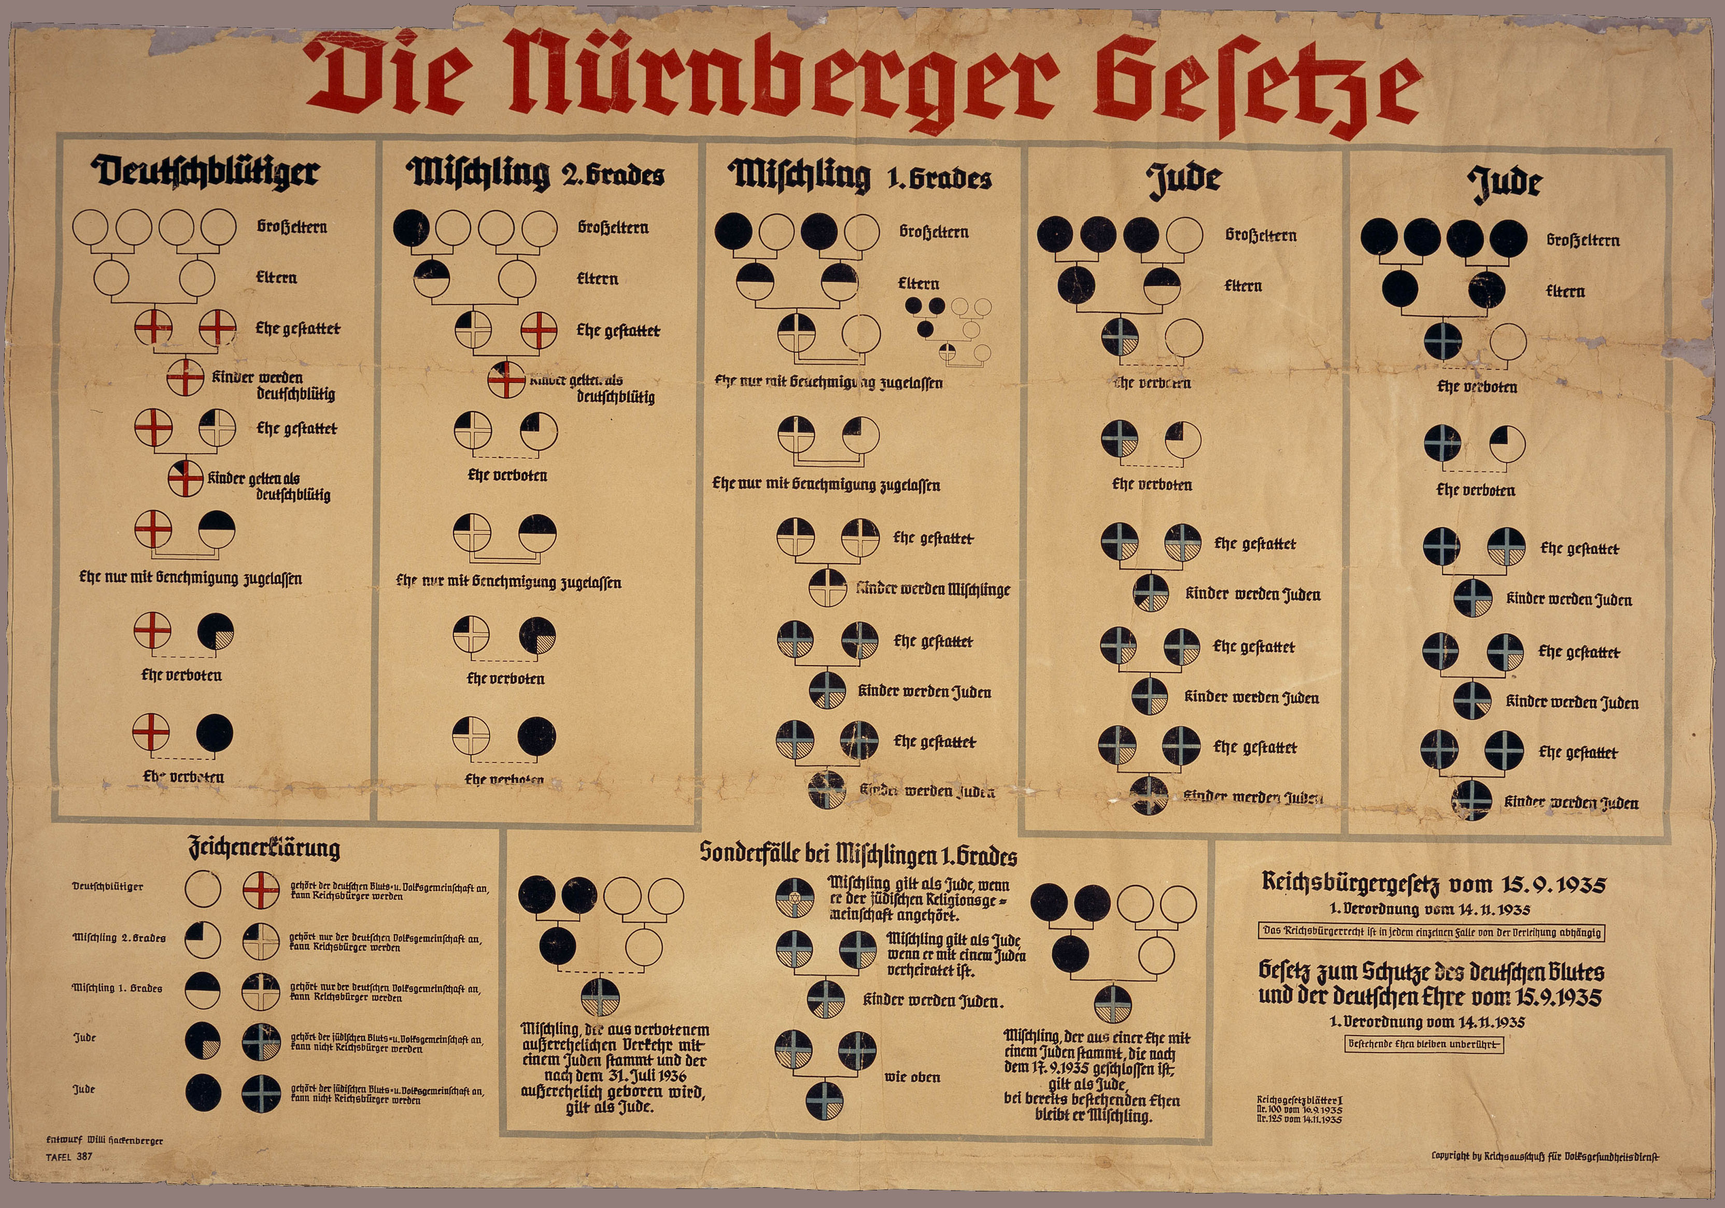

Slide 8
Kristallnacht: The Night of Broken Glass
ADD SA – sturmabteilung: rank and file members of the nazi party. Hostile to opposition groups
ADD Hostile groups forced into concentration camps
November, 1938: Ernst von Rath (German diplomat in Paris) murdered by Herschel Grynszpan, a Polish Jew.
Touches off mass rioting in Germany for 2 days.
Destruction of Jewish Synagogues, 100 deaths, 30,000 arrests.
Jewish publications ceased.
Jewish businesses must be transferred to non-Jews.
The Holocaust begins.

Slide 9
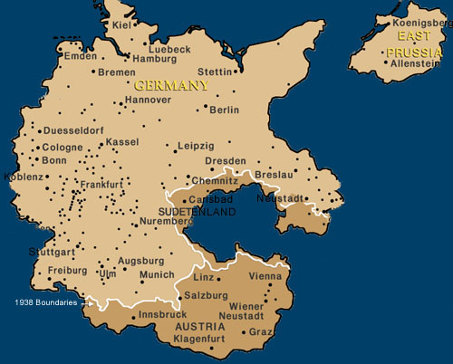
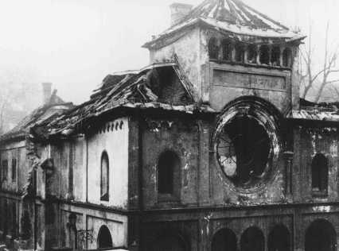

Slide 10
War
German invasions of Czechoslovakia, Poland, Belgium, France, etc., add millions of Jewish people under the control of the Reich.
Ghettoization – Forced removal of Jewish people from their homes and into ghettos
Generalplan Ost – Resettlement plan of the Reich. Remove 35-40 million Slavic peoples from East Europe/Russia and resettle with Germans.

Slide 11
Ghetto
1000+ ghettos established in Nazi occupied territories. Forced removal of Jews from their homes to the ghettos
Jewish Council (Judenrate) – quasi-governmental body in charge of the ghetto under the authority of the Reich.
2 largest ghettos in Poland: Warsaw (400,000) and Lodz (200,000).
Temporary locations for Jews while the Reich ponders a permanent plan.

Slide 12
http://www.youtube.com/watch?v=DxtlTnQFDyg

Slide 13
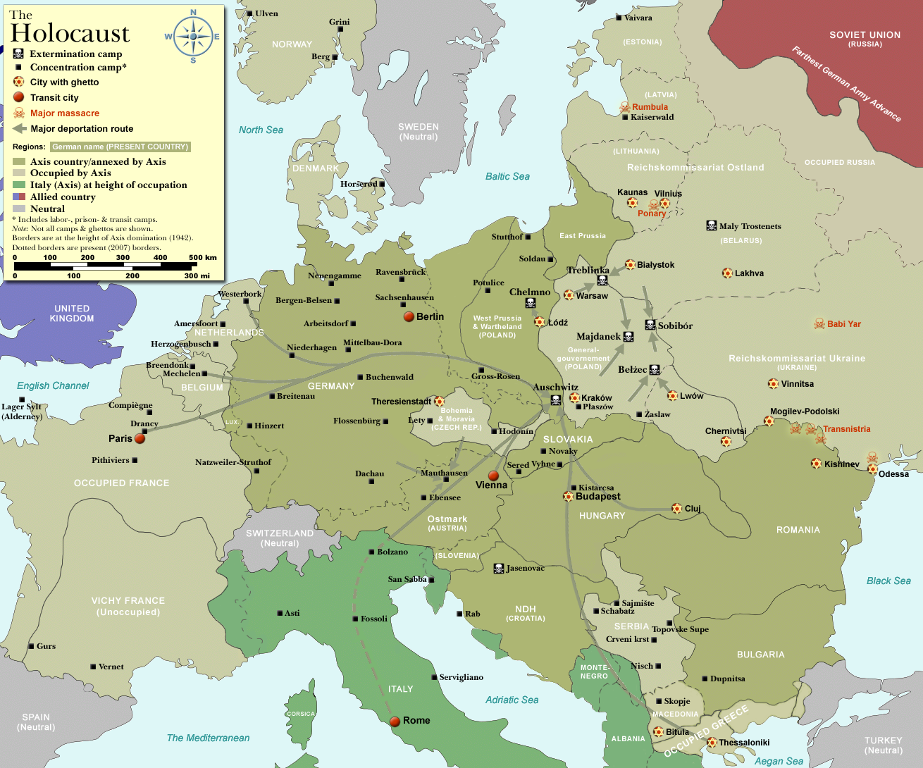

Slide 14
Conditions
Large population on small percentage of land – a few square miles.
Food: Anywhere from 200-600 calories per day of bread. Smuggling rampant.
Sanitation: depends where you live.
Heat: little fuel to keep people warm
Result: anywhere from 10%-50% of people residing in ghettos from 1940-42 died because of starvation, disease, exposure.

Slide 15
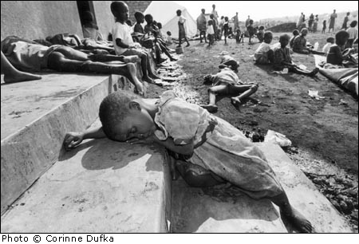
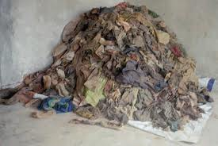
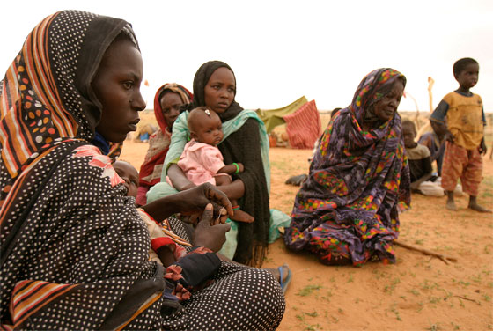
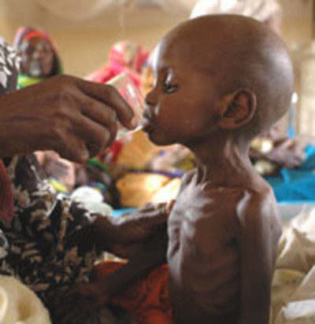
Rwanda
Darfur

Slide 16
Final Solution
Einsatzgruppen: SS action squads responsible for frontline murder of undesirables.
Gassings are common at concentration camps.
Executions on the frontlines by German soldiers are inefficient. Hurts morale.
1942: Wannsee Conference – meeting of top logistic, legal, military, cultural, foreign policy, Reich officials to organize the final solution. Heinrich Himmler and Reinhard Heydrich orchestrate.
Operation Reinhard: Destruction of ghettos, removal of Jews from ghettos to concentration/death camps.

Slide 17
Death Camps
Kulmhof (Chelmno), Belzec, Sobibor, Treblinka, Lublin (Majdanek), and Auschwitz
Kulmof: gas vans – 150,000
Belzec: carbon monoxide – 600,000
Chelmno: 150,000 deaths. 2 survivors.
Sobibor: gas – 250,000
Treblinka: 700,000 – 800,000
Lublin: 50,000 gassed or shot
Auschwitz: hydrogen-cyanide gas 1,000,000

Slide 18
Liberation
From 1942-45 there are ghetto/camp uprisings. All fail.
By the winter of 1944, the eastern camps were emptied and demolished. Prisoners were forced to march to western camps.
Soviets liberate the death camps of eastern Europe.
Nuremberg Trials are established to prosecute those who commit:
War Crimes (military)
Crimes against humanity (civilian)

Slide 19
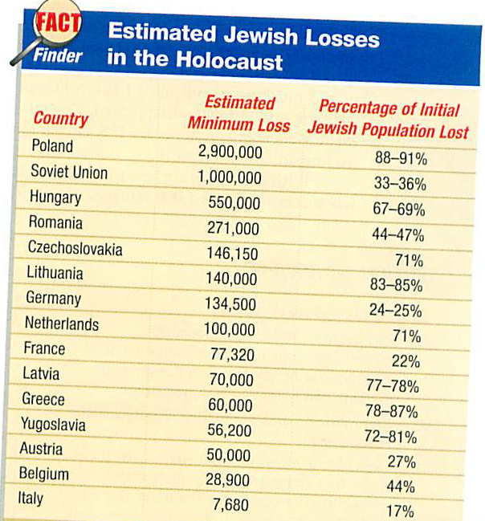

Slide 20
Righteous Among Nations
Yad Vashem – Israel’s official remembrance of the Holocaust
Righteous Among Nations – Gentiles who risked their lives to save the lives of Jews.
Poland: 6000
France: 2500
German: 500
USA: 3

Slide 21
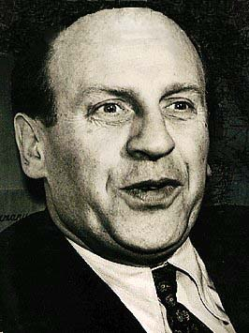
Oskar Schindler Nicholas Winton

Slide 22
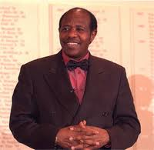
Paul Rusesabagina Rachel Koretsky
http://www.nytimes.com/2006/05/07/opinion/07kristof.html

Slide 23
Final Quotes
The receptivity of the great masses is very limited, their intelligence is small, but their power of forgetting is enormous.
Adolf Hitler from Mein Kampf

Slide 24
“Whoever destroys a single life is as guilty as though he had destroyed the entire world; and whoever rescues a single life earns as much merit as though he had rescued the entire world.”
Talmud

Slide 25
“We Didn’t Know”
http://www.nytimes.com/2013/03/03/sunday-review/the-holocaust-just-got-more-shocking.html?pagewanted=all&_r=1&

