Slide 1
The Korean War
The Forgotten War

Slide 2
1949
Russia detonates an Atomic Bomb
Duck and Cover
Chinese communists win a civil war. Force the Nationalists to flee to Taiwan.
US populace feels insecure.
Alger Hiss
Rosenberg’s
McCarthy
Containment – Truman Doctrine
Domino Theory

Slide 3
History of Korea
Mongolia invasion 16th and 17th centuries
Chinese Invasions 16th and 20th centuries
French Invasions 19th Century
Japanese Invasions 17th and 20th centuries
Civil war (north and south)
Lots of wars over control of the Korean Peninsula

Slide 4
WWII
Japan invaded and controlled Korea during WWII
After the war, Korea is divided in two: 38th parallel is the border between North and South
USSR monitors NK. Americans monitor SK.
National elections would be held to elect a president who would then rule a reunified Korea
Elections don’t occur.
North – communist government with Kim il-Sung as the leader
South – limited democracy led by Syngman Rhee.
Americans and Soviets withdraw from Korea.

Slide 5
The Invasion
China and USSR both militarily support North Korea.
South Korea very anti-communist (jailed/murdered communists)
South Korea’s military is weak, made weaker by the US military withdrawl.
Kim il-Sung wants to reunited and rule South Korea.
North Korea invades South Korea in June, 1950.

Slide 6
US Response
By September, 1950 NK conquers most of Korea.
Pusan Perimeter
President Truman orders General Douglas MacArthur to arm South Korea’s army, and get US forces ready for an invasion.
UN Security Council approves US authorization to fight communist NK. Soviets were absent when the vote was held.
Inchon Landing– counterattack the NK forces from the west and cut off their supply route into NK. Works.

Slide 7
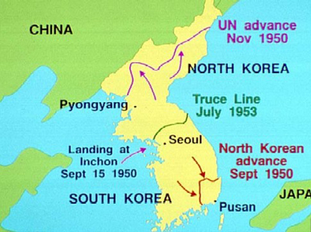
Overview

Slide 8
Chinese Intervention
By Christmas, 1950, the UN forces pushed NK back to the Yalu R. – almost border of China.
China enters the war and attacks the UN forces.
Pushes MacArthur’s forces back to the 38th parallel
MacArthur pushes Truman for a second front in China. Truman refuses. Doesn’t want a wider war with China.
Mac sends a letter to House Minority Leader, Joseph Martin, challenging Truman. Letter goes viral.
Truman relieves MacArthur of command.
2 more years of stalemate war.
Armistice “pauses” the war. Never formally settled.

