Slide 1
The New Deal

Slide 2
Conditions
Homeless lived in “shanty towns” built out of cardboard, or scrap metal, or newspapers
“Hoovervilles” – mocking President Hoover as ineffective in dealing with the depression.
Hobo – migratory homeless.
Soup Kitchens/Bread Lines – private charities to keep the homeless fed.

Slide 3
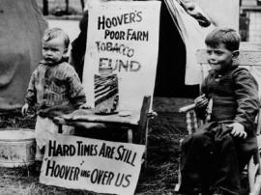
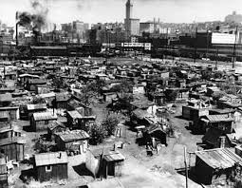

Slide 4
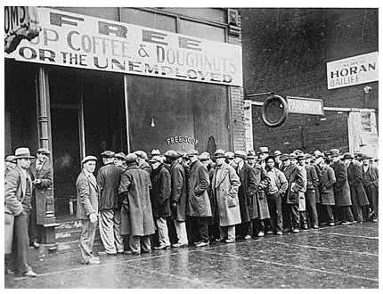
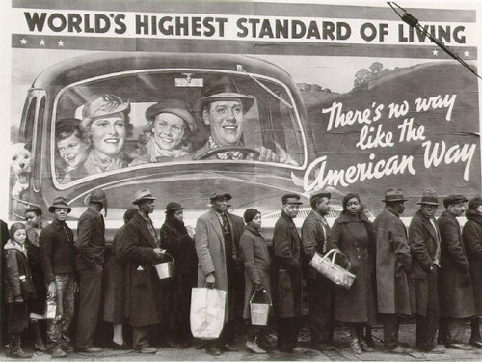
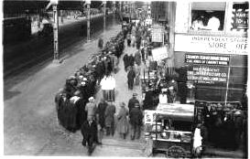

Slide 5
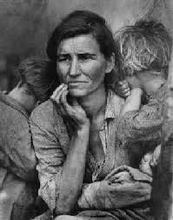
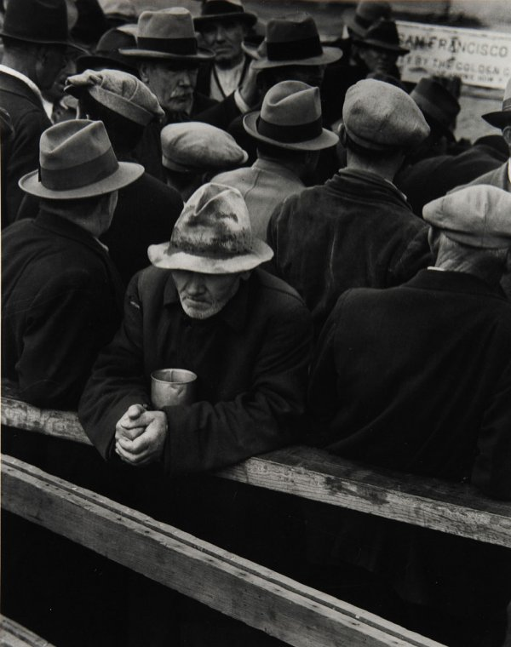
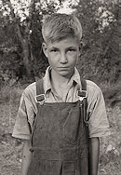
Dorothea Lange
Photographer who captured the depths of poverty and despair.

Slide 6
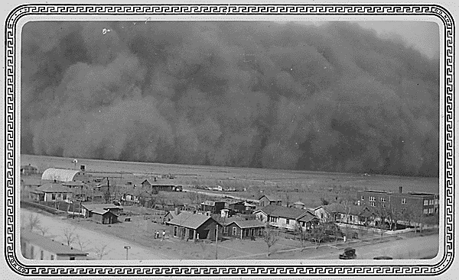
Dust Bowl
“Dirty Thirties” – over cultivated land and severe drought led to massive dust storms. Ag production hurt.

Slide 7
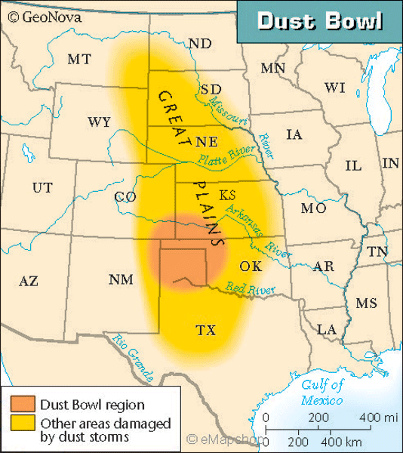

Slide 8
Family
Reduction of all essential and non-essential daily costs.
“relief gardens” – grown own food
Divorce rate down. Birth rate down.
Men embarrassed not to have a job.
Women were accused of taking jobs away from men.
Child labor.
Discrimination against women, Hispanics, Asians, African-Americans, immigrants

Slide 9
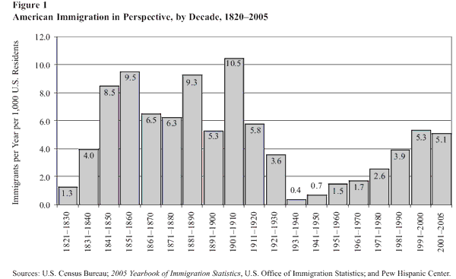

Slide 10
President Hoover
Hoover tried…
Rugged Individualism
Reconstruction Finance Corporation (RFC)
-- credit to banks to loan to consumers (perception?)
Hawley-Smoot tariff
Voluntary Action
“Economic depression cannot be cured by legislative action or executive pronouncement. Economic wounds must be healed by the action of the cells of the economic body – the producers and consumers themselves.”

Slide 11
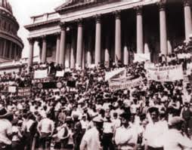
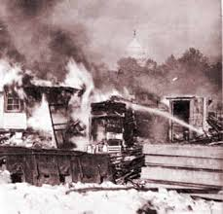
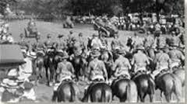
Bonus Army
Summer of 1932 – 20,000 WWI Veterans marched on Washington D.C. demanding pension bonuses promised in 1945.
General Douglas MacArthur was ordered to disperse the Hooverville that sprung up outside of the capitol.

Slide 12
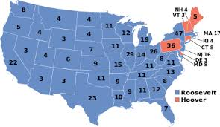
1932 Presidential Election (472-59)

Slide 13
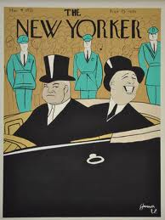
Inauguration Day

Slide 14
“The only thing we have to fear is fear itself”
New Deal – the programs, agencies and legislative acts intending to counter the Great Depression.
3 R’s: Relief, Recovery, Reform.
“100 Days” – legislative action undertaken within the 1st 100 days of a new president’s administration.
Bank Holiday – All commercial banks closed for 4 days.
Emergency Banking Act – US Gov can inspect banks financial records and deem them safe. (Stress Test in today’s words)
FDIC – Federal Deposit Insurance Corp. Insurance on all consumer bank holdings.

Slide 15
Financial Reform
Glass-Steagall Act (aka Banking Act of 1933)
FDIC – Federal Deposit Insurance Corp. Insurance on all consumer bank holdings.
Prohibits commercial banks from owning investment banks.
Net deposits of $1 Billion by summer of 1933.
Fireside Chats – Weekly radio addresses to pep up Americans’ spirits.

Slide 16
Alphabet Soup
Series of programs designed to build infrastructure, provide an income, and build up the consumer economy.
Keynesian Economics – when consumer spending falls, government makes up the difference until consumers rebound.
CWA (Civil Works Administration) 1933 – built roads, parks, airports. 4 million employed.
CCC (Civilian Conservation Corps) – restoring and maintaining forests, beaches, parks by young men. 2.5 million employed.

Slide 17
Industry
NIRA (National Industrial Recovery Act) created the National Recover Adm. (NRA)
Regulate wages, conditions, production and prices of consumable goods
Set a minimum wage and collective bargaining rights for unions
PWA (Public Words Adm.) – Grand Coulee Dam in Washington, causeway connecting Key West to Florida, and other bridges, roads, etc.
Federal Securities Act – All publicly traded companies must share certain financial information with the public.
Securities and Exchange Commission (SEC) – regulates the financial markets.

Slide 18
Homes/Farms
HOLC (Home Owners’ Loan Corp.) – refinanced loans for home owners to keep their houses.
AAA (Agricultural Adjustment Act) –
Subsidies for agricultural goods
Paid farmers not to farm (lower supply)
Tennessee Valley Authority – Link industry, forestry and flood prevention in the TN Valley to create an environment hospitable for industrial purposes.

Slide 19
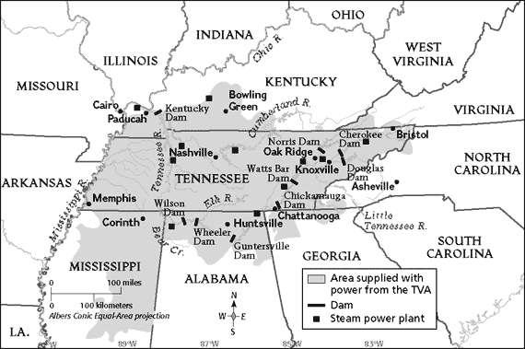

Slide 20
The Supreme Court
NIRA and AAA unconstitutional. Too much power for the president.
Judicial Reorganization Bill – increase the number of Supreme Court justices.
“Court packing” or “court stacking” to approve FDR’s programs.
Bill died in Congress.

Slide 21
2nd New Deal
Economic recovery was flat for FDR’s first term.
WPA (Works Progress Adm) – playgrounds, schools, hospitals, roads, airports. 8 million employed.
National Labor Relations Act (Wagner Act) – legalized union collective bargaining, outlawed blacklisting.
Fair Labor Standards Act – outlawed child labor, set the workweek at 40 hours and federalized a minimum wage.

Slide 22
Social Security
Old age pension and survivors benefits
Unemployment insurance (welfare) for people out of work.
Aid for dependent children, the blind and physically disabled.

Slide 23
Problems and Critics
National debt -- $21 billion to $43 billion by 1940.
No permanent recovery.
Socialism argument
Nationalization argument
Huey Long
American Liberty league
Upton Sinclair
Charles Coughlin

Slide 24
