Slide 1
The Vietnam War

Slide 2
Background
2000 year history as a country/people
Constantly fighting off invasions from neighboring interests (countries, dynasties, groups)
By early 1800’s, France “controls” Vietnam’s economy. Called Indochina back then.
Ho Chi Minh (Vietnamese nationalist) rallied support to kick the French out of Vietnam in the 1950’s.
Nationalists called the Vietminh
Communist sympathies make him an automatic enemy to the US

Slide 3
Geneva Conference
Fighting between France and the Vietminh is settled by a battle, Dien Bien Phu in May of 1954. France loses. Leaves Vietnam.
GC – France, US, China, Britain, Vietnam, Laos, Cambodia try to settle independence issues.
Results:
Indochina is divided in ½ (N & S Vietnam)
Ho controls N, Ngo Dinh Diem controls S
Elections will eventually reunited the country
Elections never happen.

Slide 4
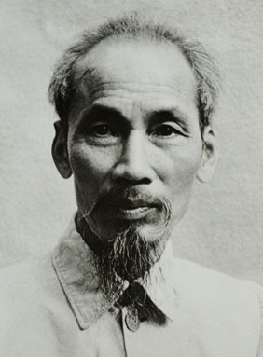
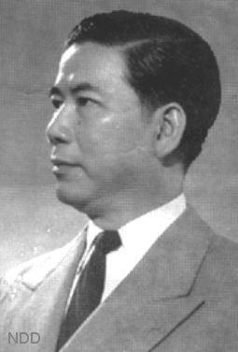
Ho Chi Minh Ngo Dinh Diem

Slide 5
US Involvement
Zero-Sum Gain. Losing a country to communist control is a gain for the other side (-1/+1)
Domino Theory – 1 country falls to communist, neighboring countries fall to communism.
1955 – US economic/military aid to Vietnam begins.
1960 – “Military advisors” (600) are sent to Vietnam to train Vietnamese counter-insurgency techniques.
1963 – 16000 “military advisors” in Vietnam

Slide 6
Ngo Dinh Diem
Bad guy. Corrupt. Puts family members in key positions in government. Catholic in a Buddhist country. Jails/kills people he doesn’t like.
Buddhist monks, as a sign of protest, light themselves on fire in the streets of Saigon.
US blesses a coup d'état by S. V. military.
Diem is shot/killed November 2, 1963.

Slide 7
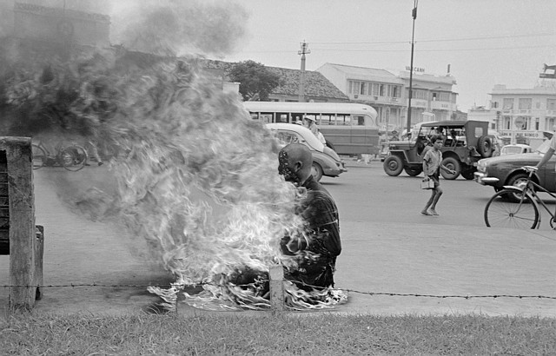

Slide 8
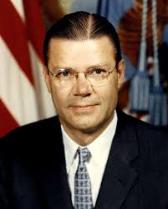
Robert McNamara
Business man. Former president of
Ford Motor Co.
JFK makes him Secretary of Defense.
“Flexible Response” – less reliant on nuclear force, more special force.
Pushes for more US involvement because Vietnamese can’t defend themselves.
“White Paper memo” – send troops to Vietnam.

Slide 9
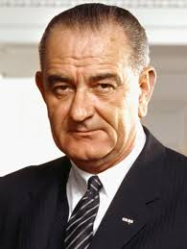
LBJ
Viet Cong (south Vietnamese guerrilla forces) owned the countryside of Vietnam.
LBJ: “I’m not going to lose Vietnam. I am not going to be the President who saw Southeast Asia go the way China went.”
1964 Re-election campaign: no
Vietnam War for US.

Slide 10
Gulf of Tonkin
August 1964, 2 North Vietnamese Army (NVA) torpedo boats attacked a US destroyer in the Gulf of Tonkin.
US responds with air bombing of nearby N. Vietnam sea ports/bases.
Congress passes Gulf of Tonkin Resolution 414-0 in House, 88-2 in Senate (502-2).
Congress authorizes President Johnson to use all measures possible to defend US troops, attack NVA.
“Blank Check”

Slide 11
Escalation
Skirmishes between NVA/Viet Cong and US troops grew.
General William Westmoreland (US commander in Vietnam) requests more troops.
US is now doing the fighting.

Slide 12
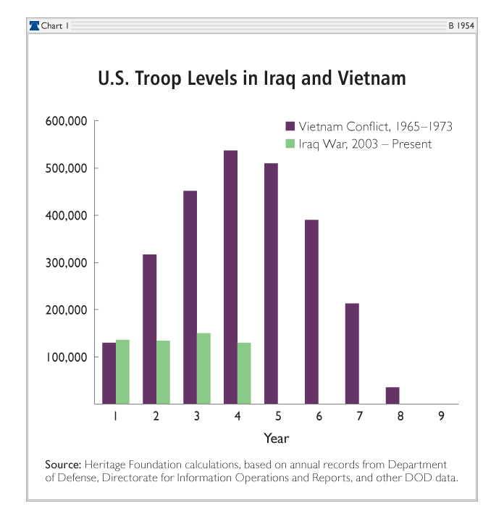

Slide 13
Tet
3 years later Tet Offensive Launched on January 30, 1968.
Cease fire – goodwill gesture – between US/NVA. 70,000 NVA attack most US bases in Vietnam in 1 day. Attacks failed militarily.
US embassy (capitol building of US presence in Vietnam) briefly captured by NVA
NVA/ Viet Cong can attack anywhere
US civilian population rethinks support for war
LBJ popularity plunges

