Slide 1
Treaty of Versailles

Slide 2
Questions
How do you satisfy justice and permanent peace groups?
How do you prevent war?
What role should the US have in international affairs, problems, disputes?

Slide 3
The Big Four
Italian PM – Vittorio Orlando
England PM – David Lloyd George
France PM – George Clemenceau
US President – Woodrow Wilson
Wilson proposes 14 Points
Freedom of the seas, right of self-determination, reduce armies, no grand alliances.
US is not interested in the spoils of war
European winners are interested in the spoils

Slide 4
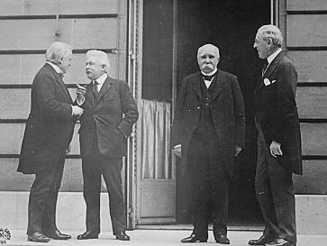

Slide 5
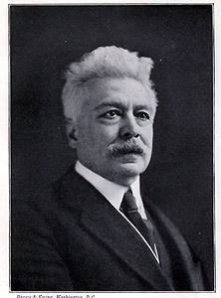
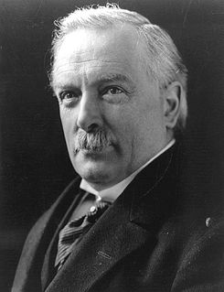
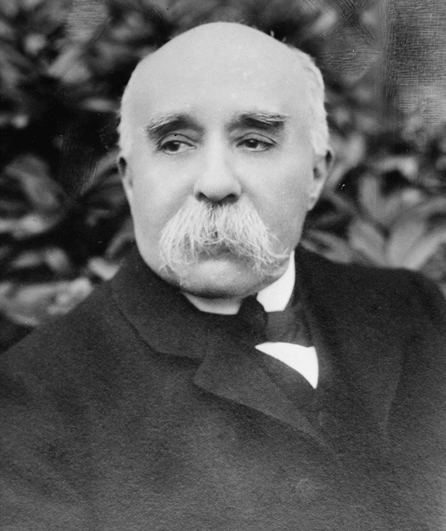
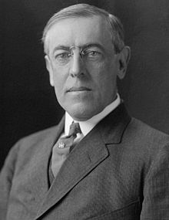

Slide 6
Paris Peace Conference
Problems:
Division of Germany’s colonies
German war guilt.
German war reparations: penalty payments to England and France for the war.
League of Nations: world congress to solve problems to prevent war.
US Senate rejects treaty.
Add to study guide: Hindenburg line
Inventions: wireless radio?

Slide 7
Odds/ends
Do the take home essays. Scantron/FIB will run 25-30 minutes.
Add Hindenburg Line to your study guide.
Remove Triple Alliance/Triple Entente.
Which of the following inventions cannot be associated with WWI?
a. Chlorine and mustard gas
b. Wireless radio
c. Airplane surveillance
d. Long-range artillery
e. Machine gun

