Slide 1
Labor

Slide 2
Recap
Robber Barons vs. Captains of Industry
Capitalism – laissez-faire
Growing inequality of wealth
8 people = 6 million
2014: 85 worth 3.5 billion
Excel: Income by percentile

Slide 3
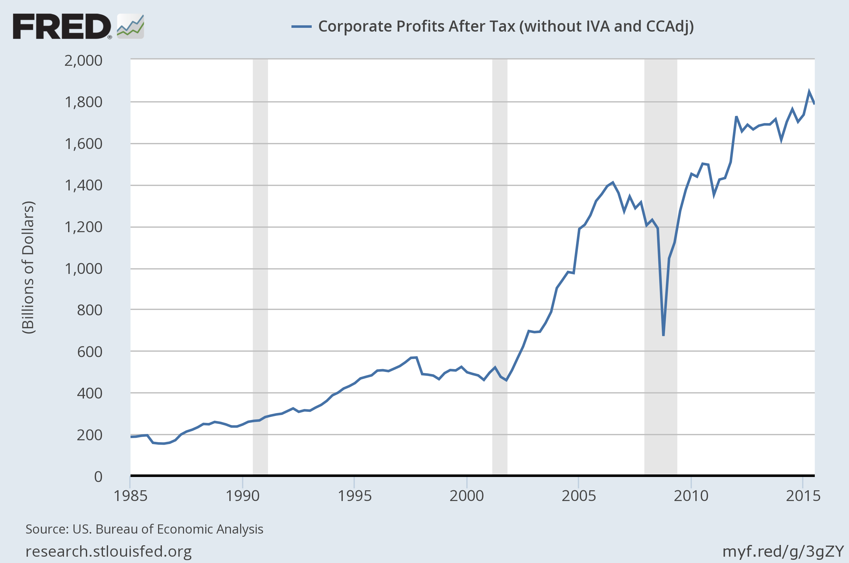
Corporate Profits After Taxes

Slide 4
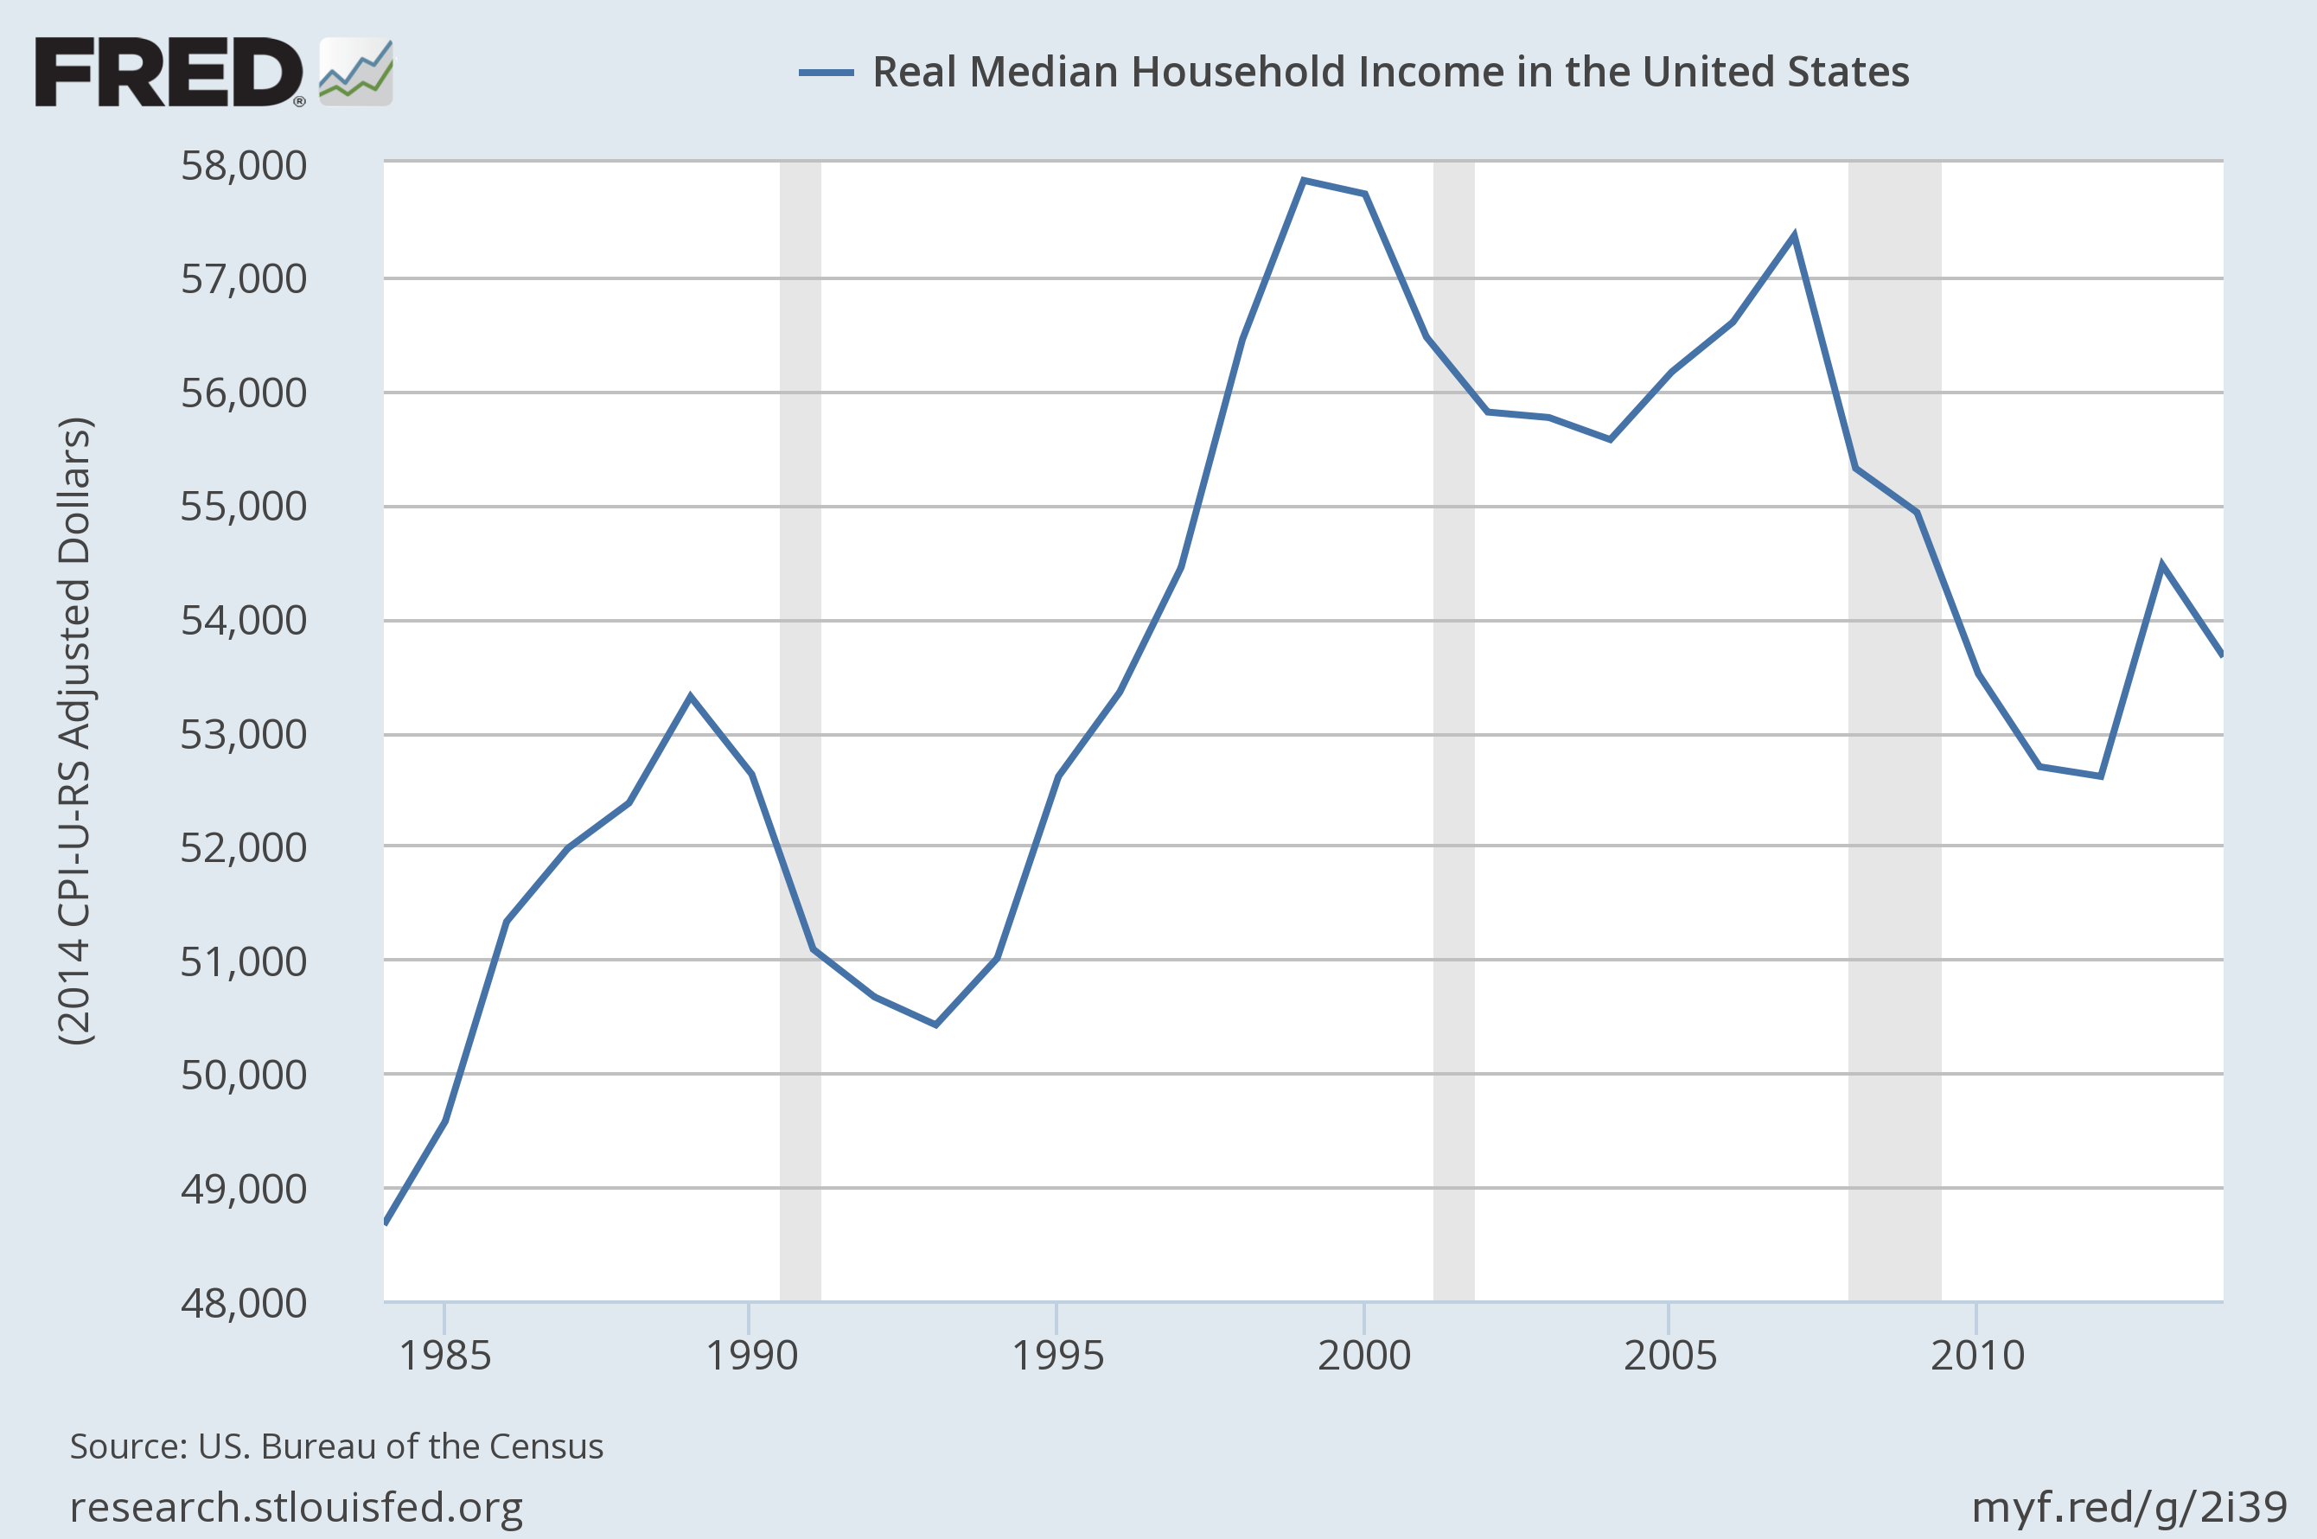
Real Median Income (US)

Slide 5
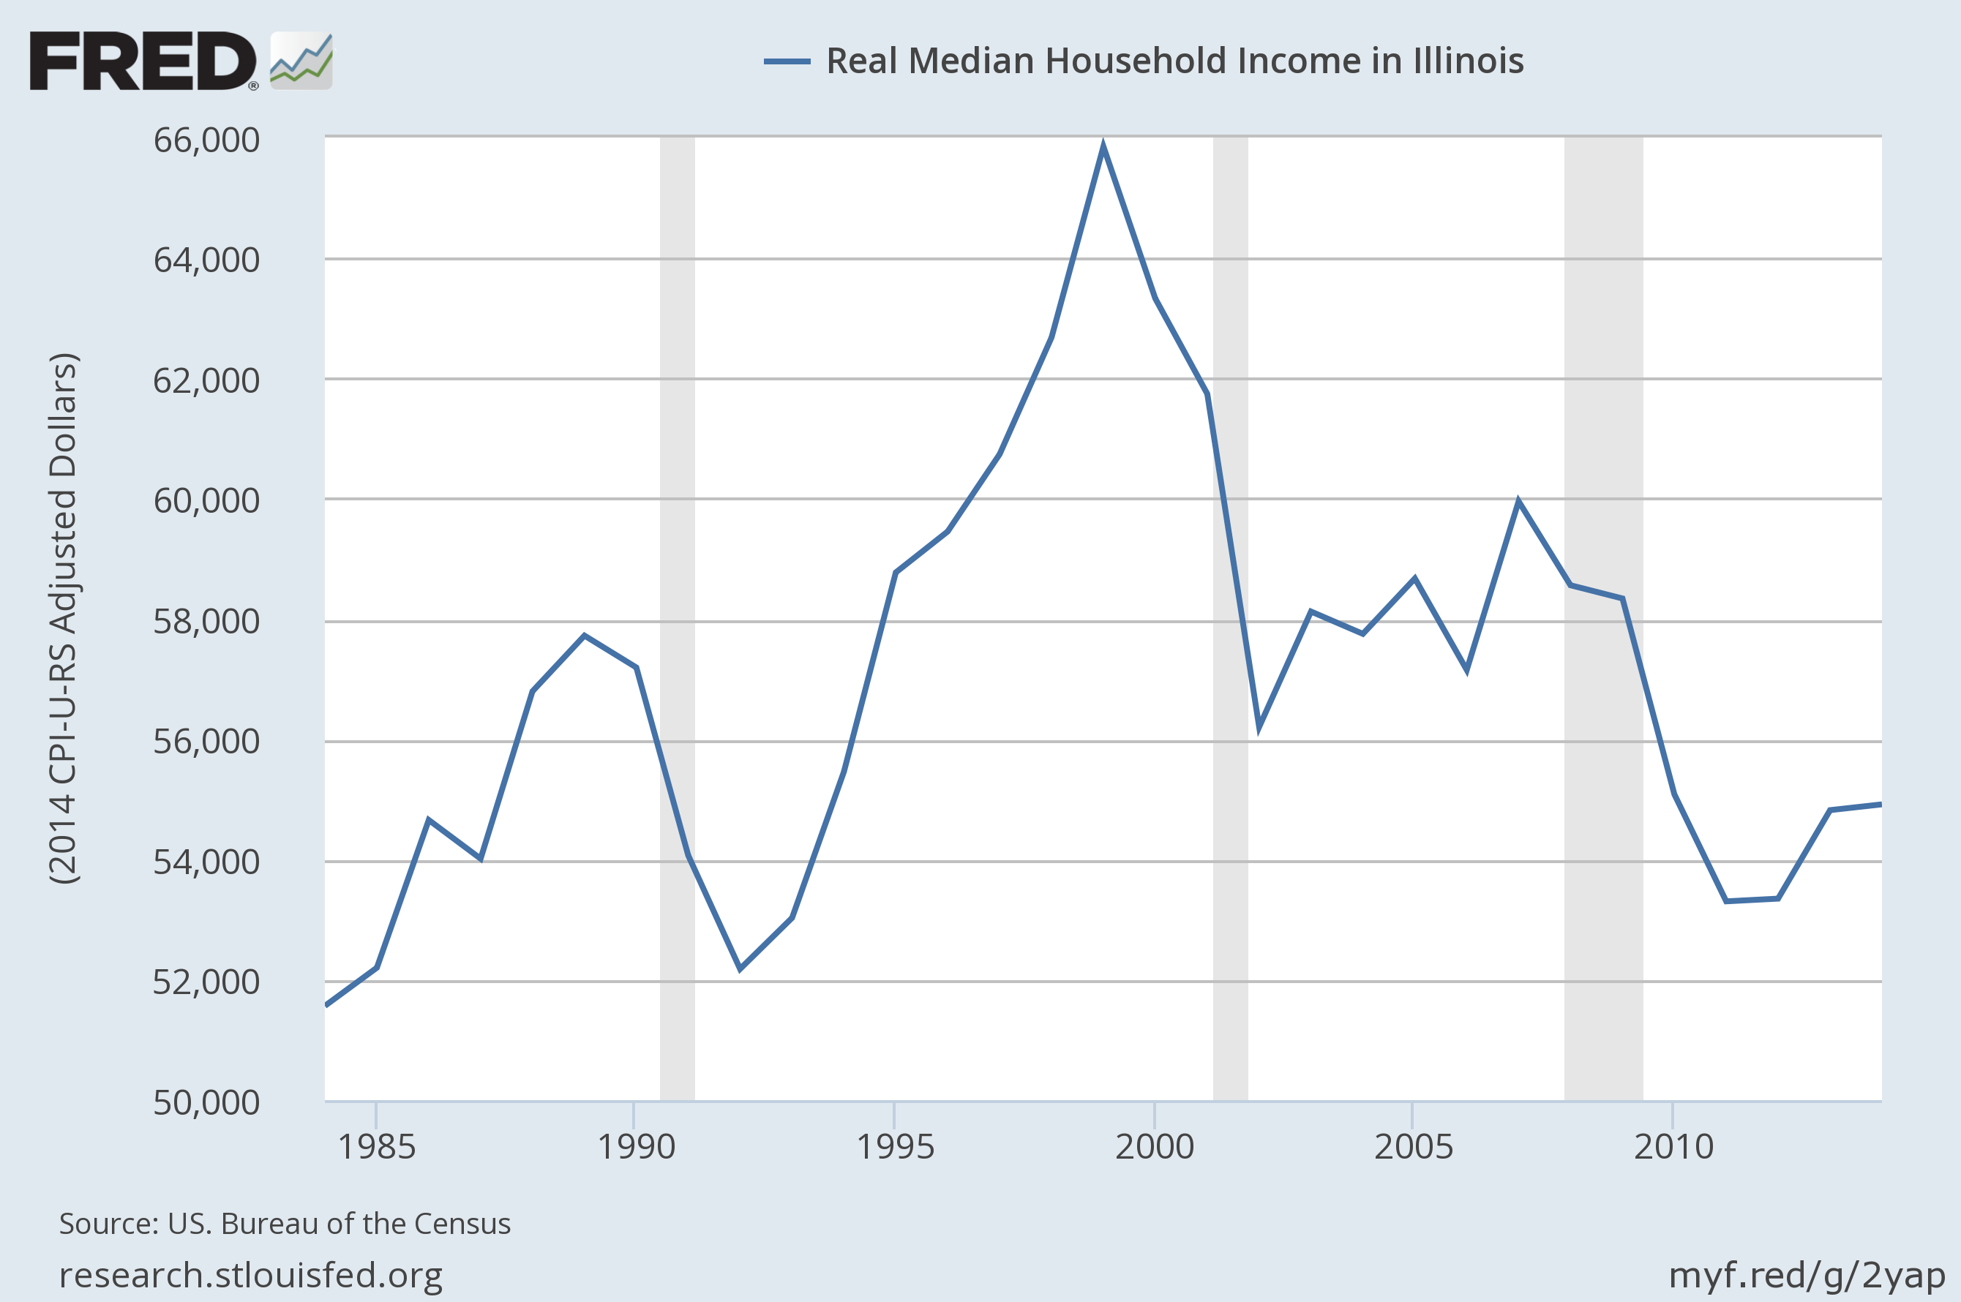
Real Median Income (IL)

Slide 6
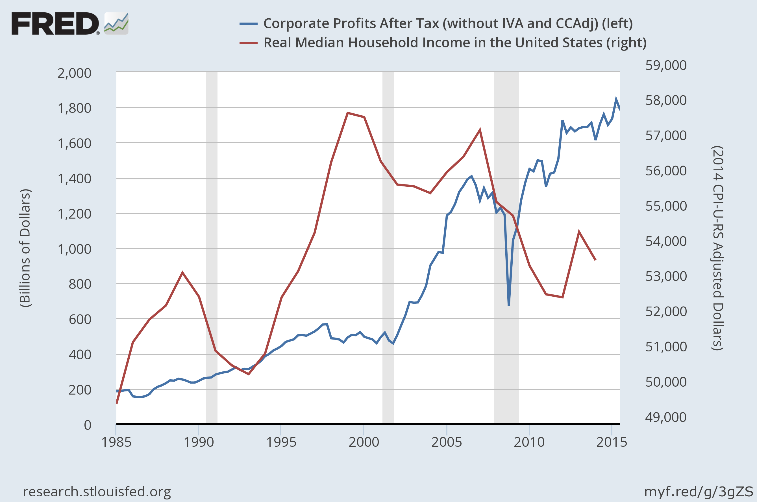
Both

Slide 7
Buzzword
Socialism – economic/political/social philosophy involving government or social intervention/control of private property and/or income.
Karl Marx and Fred Engels
The Communist Manifesto
Philosophical diatribe about the proletariat (workers) eventual overthrow of the bourgeoisie (owners).
Most Americans were/are against radical socialism
Wealthy – direct threat to capitalism and wealth
Americans – undermines traditional ideals of private property, liberties and capitalism

Slide 8
Unions
Trade unions – collective bargaining by trade in local municipalities
Philadelphia: Federal Society of Journeymen Cordwainers in 1794. (shoemakers). Outlawed in 1806 for going on strike.
Mechanics’ Union of Trade Societies – think tinkerers from Oz: the Great and Powerful.
Means for expressing workers’ angst regarding wages, hours, and safety issues.
National Labor Union – one of the first nationwide unions involving various trades.

Slide 9
Knights of Labor
Knights of Labor – 1869: organized men/women and skilled/unskilled labor into a collective group.
Farmers, factory workers, shopkeepers, office workers
Terence Powderly was the president of the union
Equal pay for equal work
8 hour workday
Did not advocate work stoppages (strikes)
Splintered by 1890.

Slide 10
AFL
AFL – American Federal of Labor
Led by Samuel Gompers
Organized skilled workers into specific trade union subgroups.
African-Americans and immigrants not invited, nor women.
The Grange Movement – unionization of farmers called cooperatives. Negotiate with mill owners and RR’s for prices of grain selling and shipment.
Wobblies – unionization of unskilled miners, lumbermen, migrant farm workers.

Slide 11
Reaction
Employers would…
Forbid union meetings (termination)
Fired union organizers
Yellow dog contracts
Blacklist union organizers
Refused to bargain collectively when workers went on strikes
Refused to acknowledge unions and/or its representatives

Slide 12
RR Strike of 1877
Baltimore and Ohio RR cut wages by 10%. 2nd wage cut in a year.
Ran “double-headers” – two engines with twice as many cars (twice the work. Think checkout at Meijer: scanner and bagger now)
RR workers strike in Baltimore and Ohio. Other RR workers stopped working in other cities: St. Louis, Pittsburg, Chicago.
Federal government sent troops to protect RR businesses.
Violence and property damage occur.

Slide 13
Haymarket Riot -- May 1, 1886
McCormick reaper factory in Chicago.
“8 hours for work, 8 hours for rest, 8 hours for what we will.”
Police break up fight between scabs and union workers on May 3rd. Tense.
May 4th, Anarchists intervene.
Anarchist – violently oppose government, and everyone for that matter.
Bomb is thrown at nearby cops. Cops killed.
Unions now associated with anarchists.
Strike over.

Slide 14
Homestead, 1892
Strike by workers at a Carnegie steel plant in Homestead, PN
Henry Frick (partner) cut wages. Strike occurs.
Frick hires Pinkertons –private police force. Police mercenaries.
Violence ensues. Union associated with violent action.
Army intervenes. Strike over.

Slide 15
Last one. 1894
Pullman Railcar Company – make railcars
George Pullman – built the factory and company town for his workers.
Utopian society: all needs/wants satisfied and all workers know their roles.
Pullman cuts wages, lays off workers after the Panic of 1893.
American Railway Union (Eugene V. Debs) strikes.
US mail is interfered with. US government orders workers to not strike. Strike gets out of hand.
Strike over.

