Slide 1
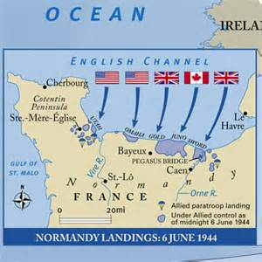
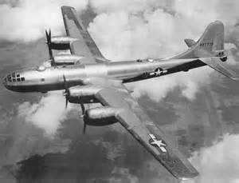
US: European Theater

Slide 2
Recap
Pearl Harbor, Coral Sea, Midway
Philippines – Bataan Death March
Island Hopping
Iwo Jima and Okinawa
Manhattan Project
Hiroshima and Nagasaki
USS Missouri

Slide 3
Mobilization
15 million Americans served in WWII
GI – Government Issue
Protect 4 freedoms:
Freedom of speech
Freedom of worship
Freedom from want
Freedom from fear

Slide 4
Newfoundland – 8/41
Atlantic Charter – Meeting between Winston Churchill (PM – England) and FDR laying out principles for eventual US Involvement.
No new territorial acquisitions
Ditto unless consent is granted.
All peoples are allowed democratic sovereignty
Free trade
Improve labor standards
United Nations
Free seas
Disarmament

Slide 5
Troops
Diversity in the armed forces. Still segregated, but barriers are breaking…slowly.
300,000 Mexican-American troops taking the Philippines
25,000 Native Americans – 300 “Code Talkers” trained to secretly communicate orders.
Japanese-Americans from the internment camps fought in the war. (1943)
442 Regimental Combat Team (4500 men)
18,000 awards: 9500 purple hearts, 5200 Bronze stars, 588 Silver Stars, 52 Distinguished Service Crosses, 7 unit citations and 1 Medal of Honor

Slide 6
Continued…
African-Americans served in combat units
Tuskegee Airmen: Black Eagles
332 Fighter Group escorted bombers
Women were accepted for all non-combat roles: office, air control towers, test pilots, mechanics, welders, you name it.
WASPs – Women Air Force Service Pilots flew planes from factory to bases and flew training missions as enemy pilots.
WAVES – Women Accepted for Volunteer Emergency Services. Piloted boats across the Atlantic.
WAAC– Women’s Army Auxiliary Corps

Slide 7
Battle of the Atlantic
Convoy System – ships traveling parallel to each other.
Wolf Pack – dozens of German U-boats sinking the convoys
Sonar – underwater pings that reveal shapes underwater.

Slide 8
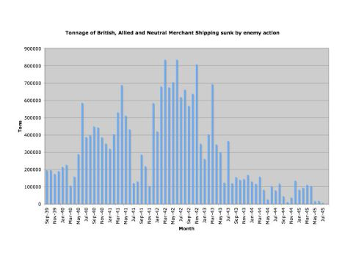

Slide 9
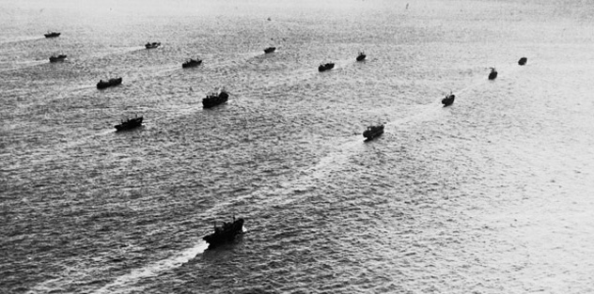
Convoy System

Slide 10
Africa Campaign
German General – Erwin Rommel, The “Desert Fox” successfully captured present day Libya, pushed the British back to Egypt.
British General Bernard Montgomery pushed Rommel back at the battle of El Alamein.
Operation Torch (11/42) – US invasion of Casablanca, Morocco and pushed east.
Casablanca Conference – Europe is primary market for US supplies. Strategy for fighting in Africa, Sicily, and Italy outlined.
Operation Husky (7/43) – Invasion of Sicily
Operation Avalanche (9/43) – Invasion of Italy

Slide 11
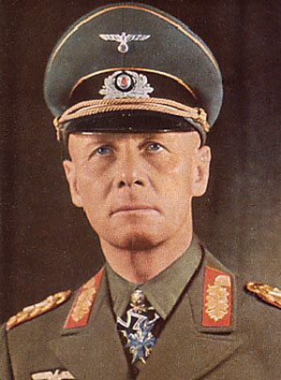
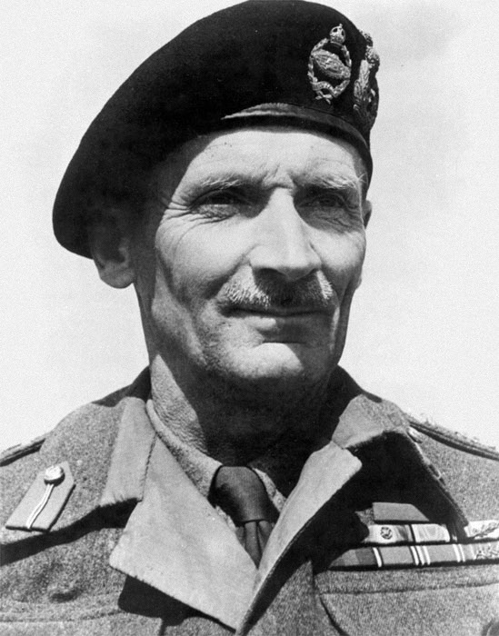

Slide 12
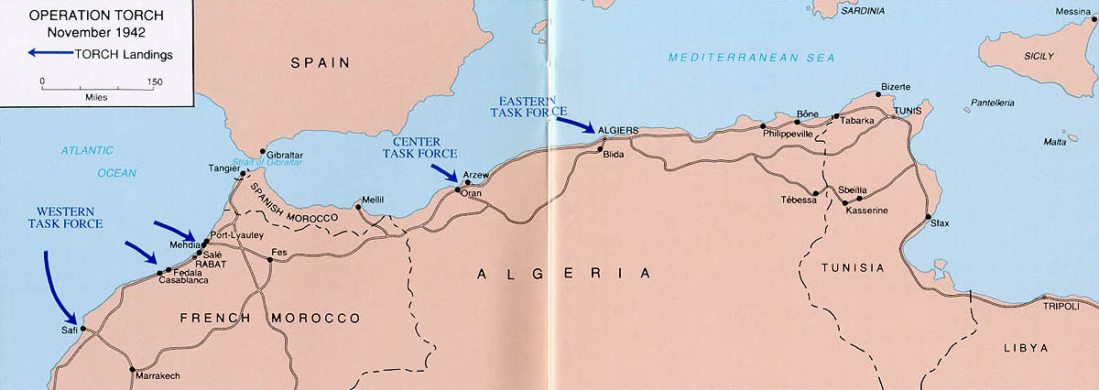

Slide 13
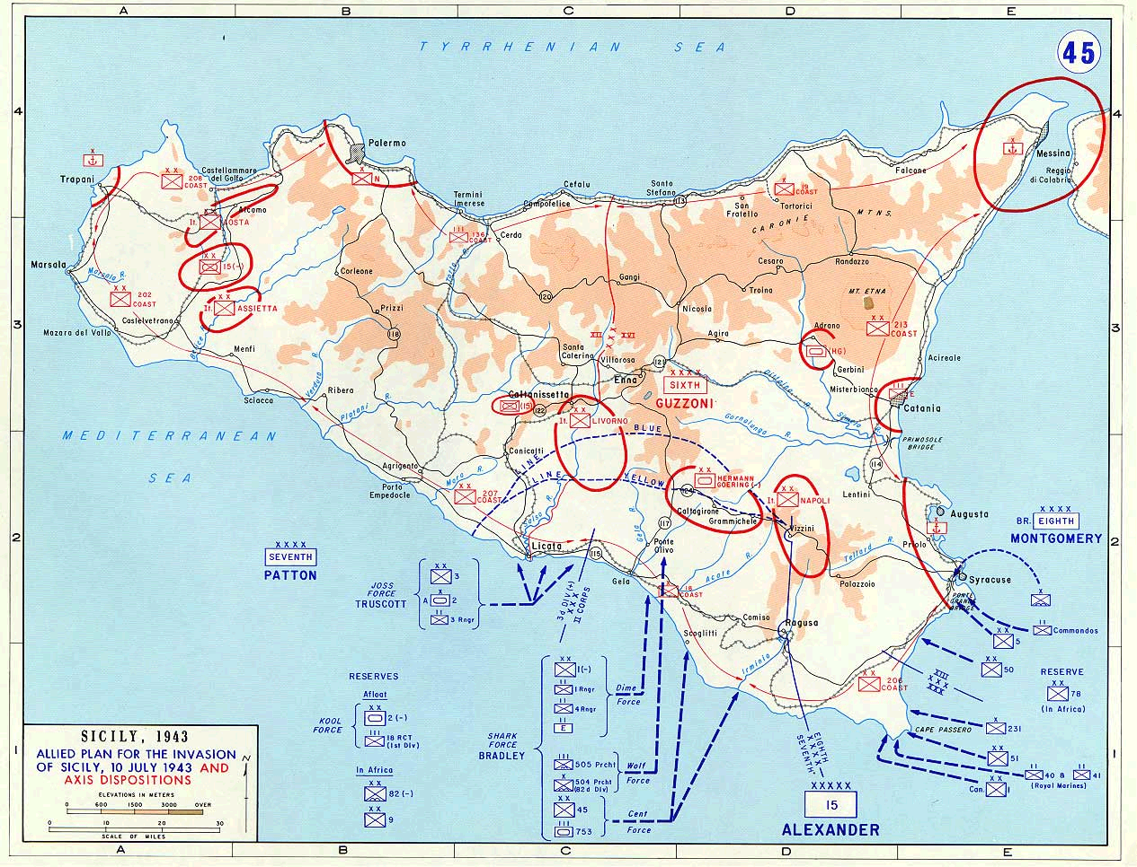

Slide 14
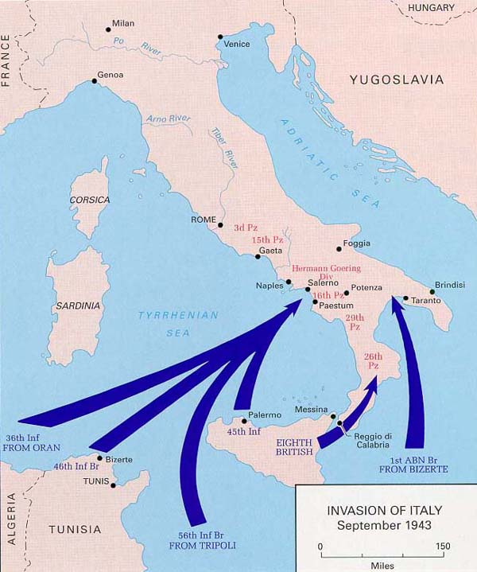

Slide 15
Operation Overlord
Teheran Conference: Joe Stalin (USSR), Churchill (England), FDR meet to discuss invasion of France.
“The Big Three”
Dwight D. Eisenhower – Supreme Allied commander of Europe.
1943 – Daytime and nighttime bombing raids of German fortifications in France, industrial targets in Germany.
Buildup and training in England for D-Day invasion.
Attack Hitler’s “Atlantic Wall” – fortified defenses along the French coast.

Slide 16
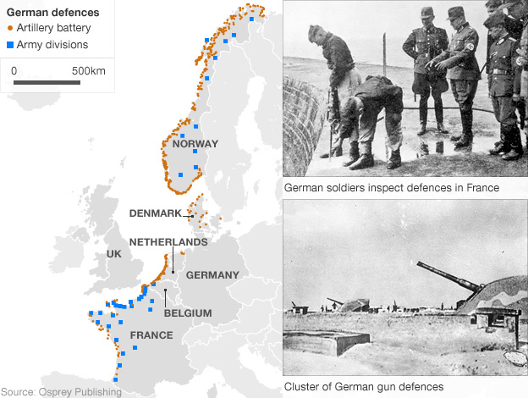

Slide 17
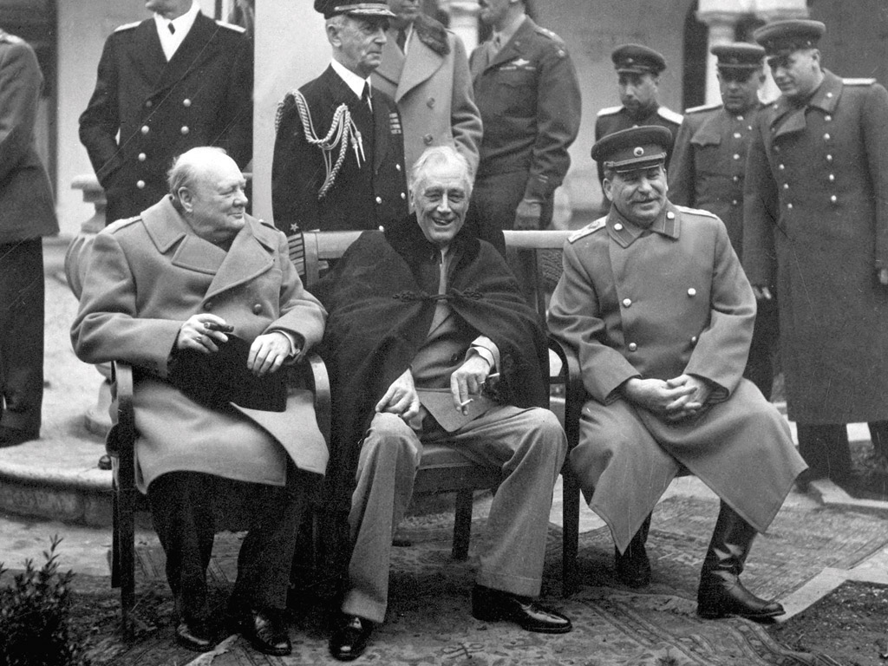

Slide 18
D-Day 6-6-1944
20K+ Paratroopers dropped behind enemy lines in France – control roads, towns, bridges for eventual linkup with main invasion force.
4000+ landing craft, 1000 planes, 150,000 allied troops and equipment invade Normandy, France.
Operation Neptune -- 5 beaches: Utah, Sword, Gold, Juno, Omaha.
Slowly but surely, a foothold is gained in northern France in the first few weeks of the campaign.
2 million troops in France by July.

Slide 19
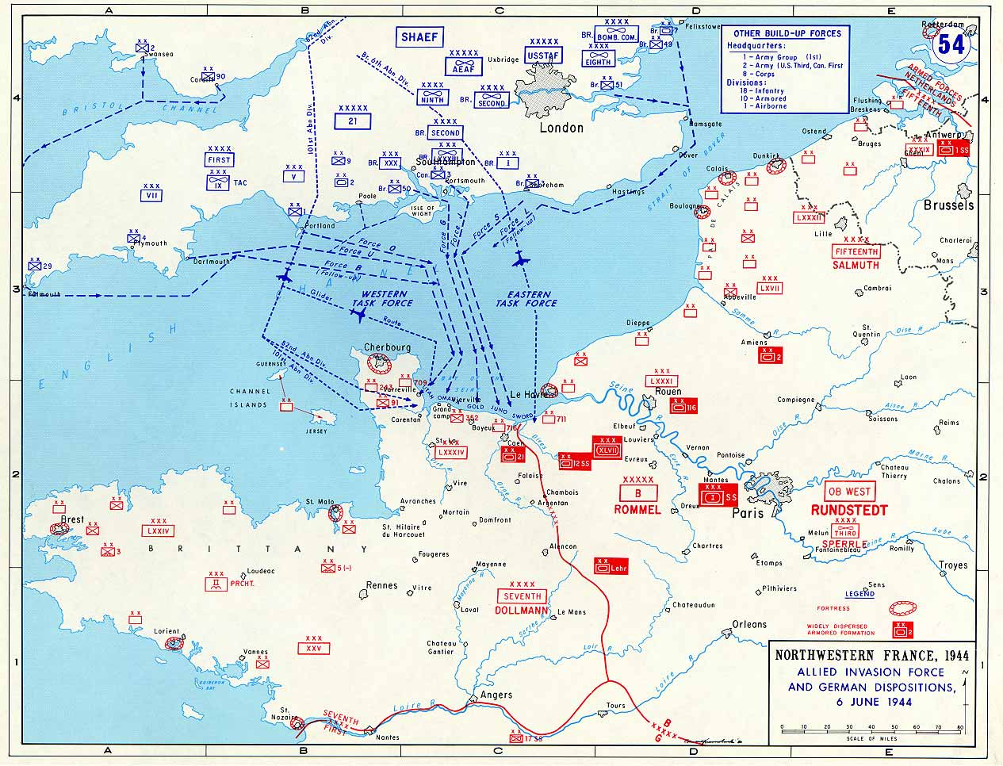

Slide 20
End of the War
Paris liberated by August, 1944.
Brussels, Belgium liberated few days later
Battle of the Bulge – German counteroffensive surrounding 101st Airborne (think of the Germans at Stalingrad). Americans broke the siege.
April, 1945 Berlin is under siege.
April 30/May 1 – Hitler commits suicide
May 8th – VE Day. Germany surrenders.

