Slide 1
Workers

Slide 2
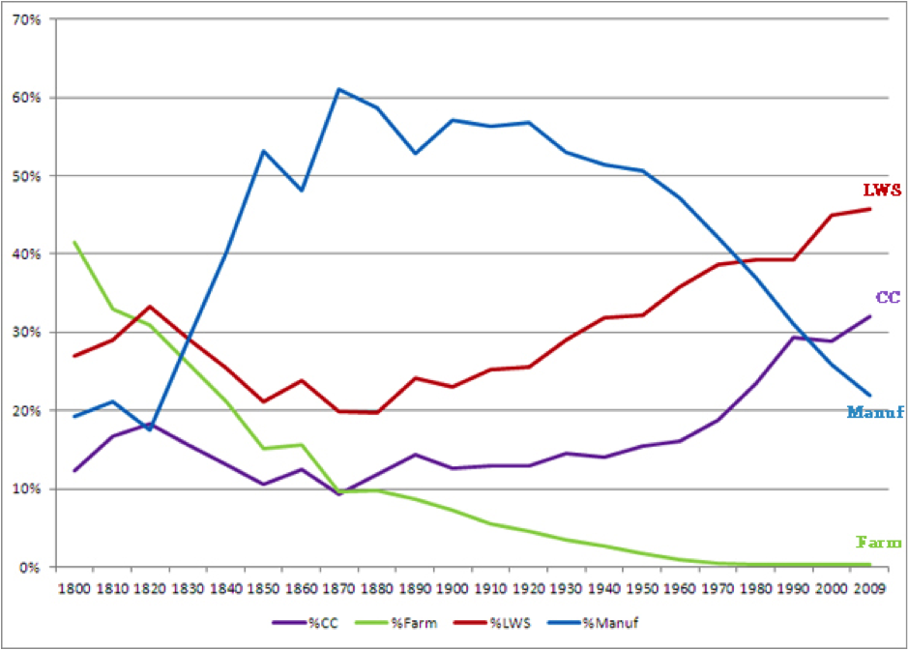
Changing America

Slide 3
Questions
What are the principle causes of the spike in manufacturing?
What are the effects?
Economic
Cultural
Political
Why the downturn and/or shift in the 1950’s through today?
Effects?
Economic
Cultural
Political

Slide 4
Industrial Growth Factors
Natural resources
Inventions
Capitalism
Surplus capital
Reconstruction
Surplus of workers willing to work
Immigration

Slide 5
Supply of Workers
People leaving the farms. Why?
Immigration – 14 million immigrants from 1860-1900
Contract Labor Act (1864): employers pay cost of passage, in return immigrants work for employers for set amount of time (up to a year).
Urbanization – people living in the cities near their jobs.

Slide 6
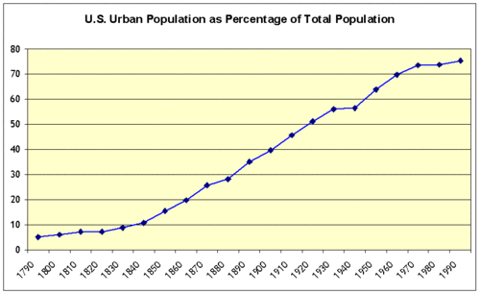

Slide 7
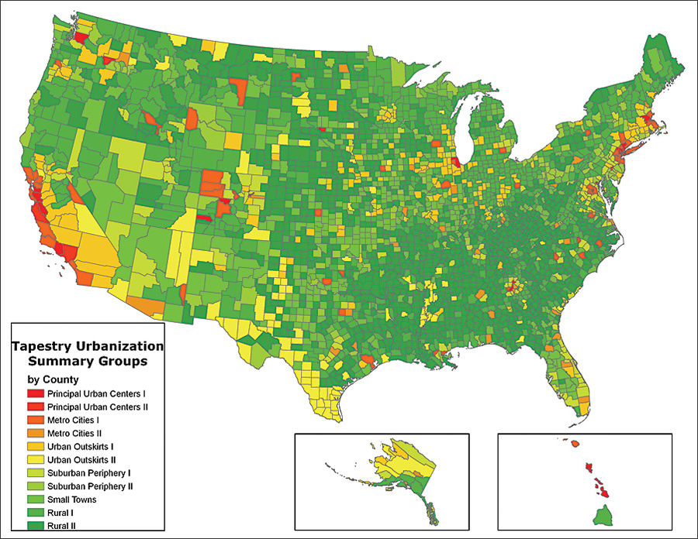

Slide 8
Work
The whole family contributed to the household income.
Kids left school to work in mines, manufacturing.
Few child labor laws
Laissez-faire economics – no government regulation. Social Darwinism.
No welfare (unemployment insurance)
No food stamps (supplemental nutrition assistance)
No social security
No Medicare/Medicaid
No workman’s compensation
Charities

Slide 9
Work
No hourly work limit
No overtime
Piecework – paid per item or gross produced
Who/what does this type of work favor?
Frederick Winslow Taylor – break large tasks into a number of steps then have a worker do one step. Goal is efficiency. Division of Labor.
Works become replaceable, low skilled.

Slide 10
Work
Takes the joy out of work
Kills morale
Loyalty and craftsmanship suffer.
Work conditions worsen. Workers are easily replaceable.
Faulty equipment, lighting, ventilation; accidents increase.
Weekly death rate in 1882 is 675 (120 in 2000).

Slide 11
Time is Money Money Never Sleeps (Sam)
Worker wages .10-.60/hour. 38-68 work week in 1900.
1913 cpi calculator (best I could find on short notice) is .10-.60 is 2.36-14.12 in 2013.
http://babel.hathitrust.org/cgi/pt?id=uc1.32106007458745;view=1up;seq=180
Depends on job and part of the country.

Slide 12
Tidbits
Racism and nativism didn’t allow for fair treatment of immigrant workers
Child labor used because little hands could more easily reach tight reaches in machines
1 our of 4 textile workers in North Carolina was a child aged 10-15.
Worked 12 hour shifts at night for little pay – 25-50 cents a day.
Unskilled adult laborers worked 60 hour weeks for less than $10 a week.
1881 – 30,000 railroad workers killed on the job.
Company towns – work for the company and live in its housing – workers paid in script, money that could only be used in that town.

Slide 13
Result
Union – collective association of workers who negotiate with the company as a singular entity.
Strike – refusal to work until satisfactory conditions are met: conditions, pay, termination, # of workers
Farmers – cooperatives: not quite a union, but banded together to sell/buy grain/supplies from companies.
Known as the Grange movement.
Companies reacted with:
Termination of employment
Blacklist – companies shared information about employees associated with unionization
Yellow dog contract – hiring workers who agree to not join a union (unions called them scabs)

